Slide 1


ESOT Membership Promotional code
September 2022

Slide 2

ESOT Members Benefits
Direct access to Transplant International and Transplant Live via Quick Links
Actively support ESOT policy initiatives
Vote in ESOT governance elections
Access to the annual ESOT grants programme
Attendance to members-only webinars
Substantial discounts for all ESOT events and courses
Access to a protected environment via the membership platform to build meaningful discussions on your preferred topics
Browse the new directory, which allows you to search for another ESOT colleague by area of expertise, affiliations, country, city or institution
Join at any time, your membership will last for 12 months from the moment of the subscription
Be part of the continued innovation ESOT is bringing in our Community
Follow @ESOTtransplant
esot.org

Slide 3
Your promotional codes for 12 months
Promo Code | Start | Discount | Price | Type of current membership | #
ESOT_yANBH_12m | 01/09/2022 |  | 25 | Trainee members + TxLive | unlimited
ESOT_ANBHmember_12m | 01/09/2022 |  | 50 | Regular Member + TxLive | unlimited
Benefits:
one-year* ESOT membership with access to ESOT e-learning platform –
Transplant Live
*The membership is valid for 365 days from the day of the activation.

Slide 4
Before you start
>>> If you are a NEW member please start your journey at page 5
>>> If you are already a member and you want to renew your membership please go to
page 11

Slide 5
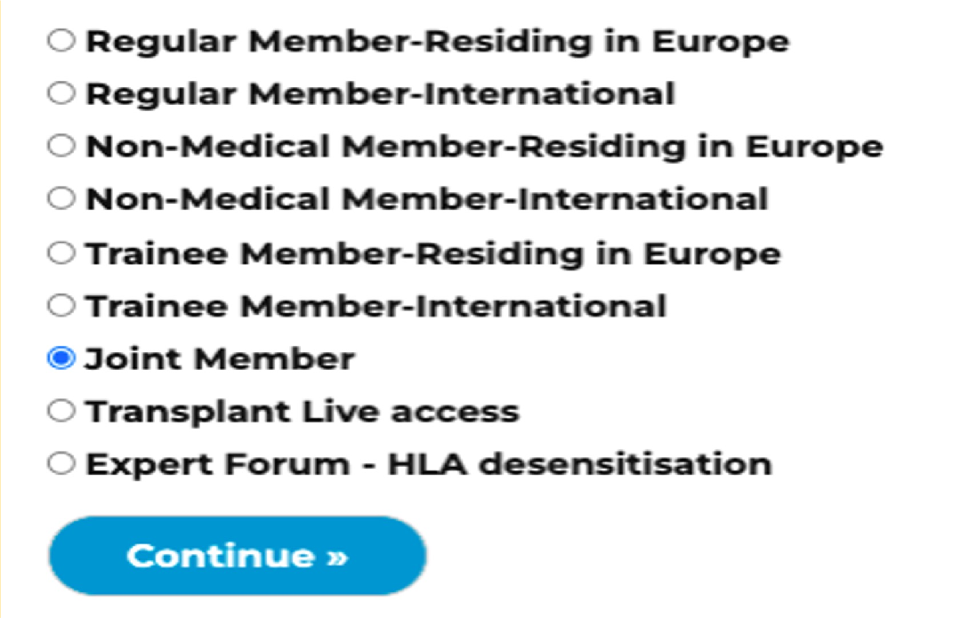
1. How to become a member and benefit from the discount
visit the ESOT membership site: https://esot.site- ym.com/general/register_member_type.asp
Select: your category as a member type and click Continue
EXAMPLE

Slide 6
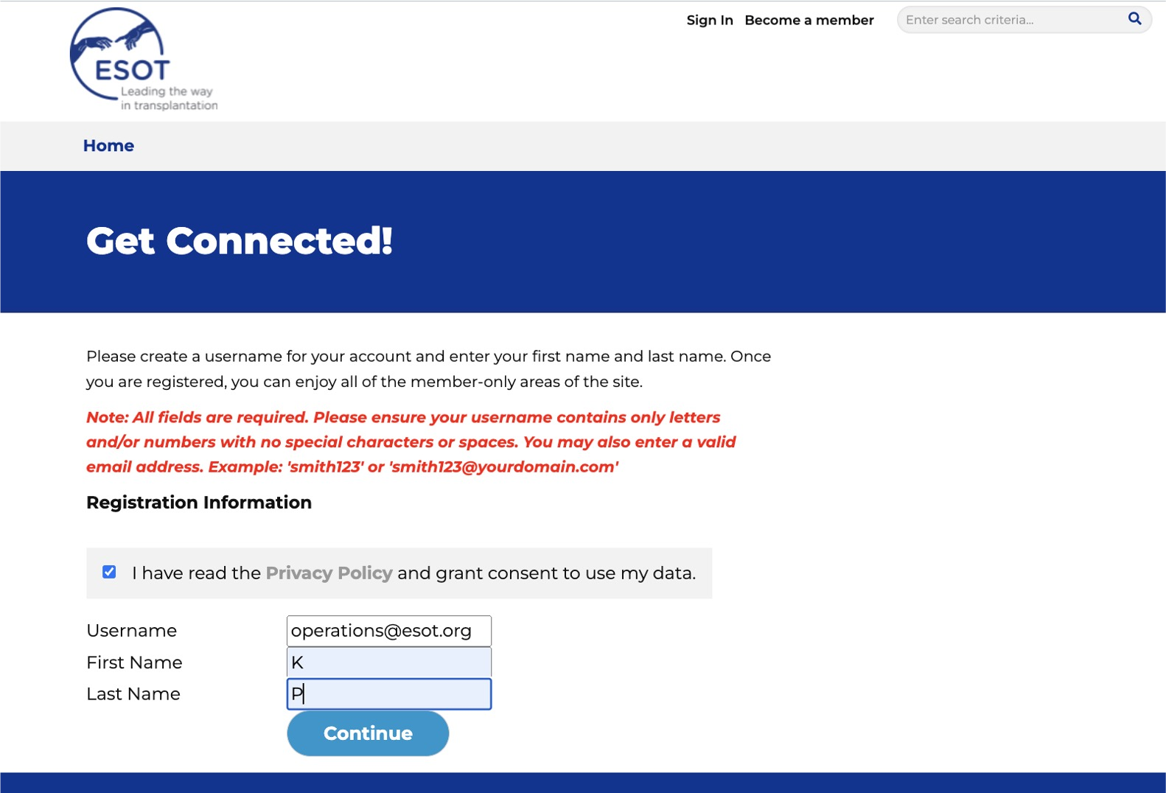
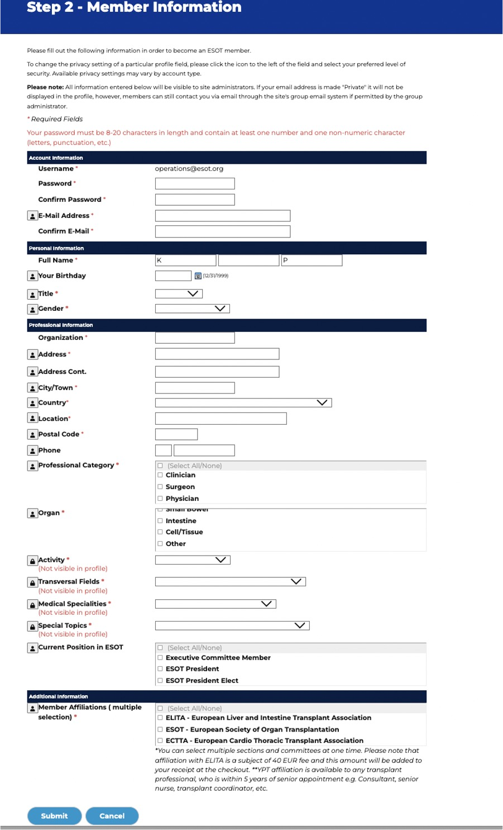

1. How to become a member and benefit from the discount
3. Follow the member registration steps by creating a username and password.

Slide 7
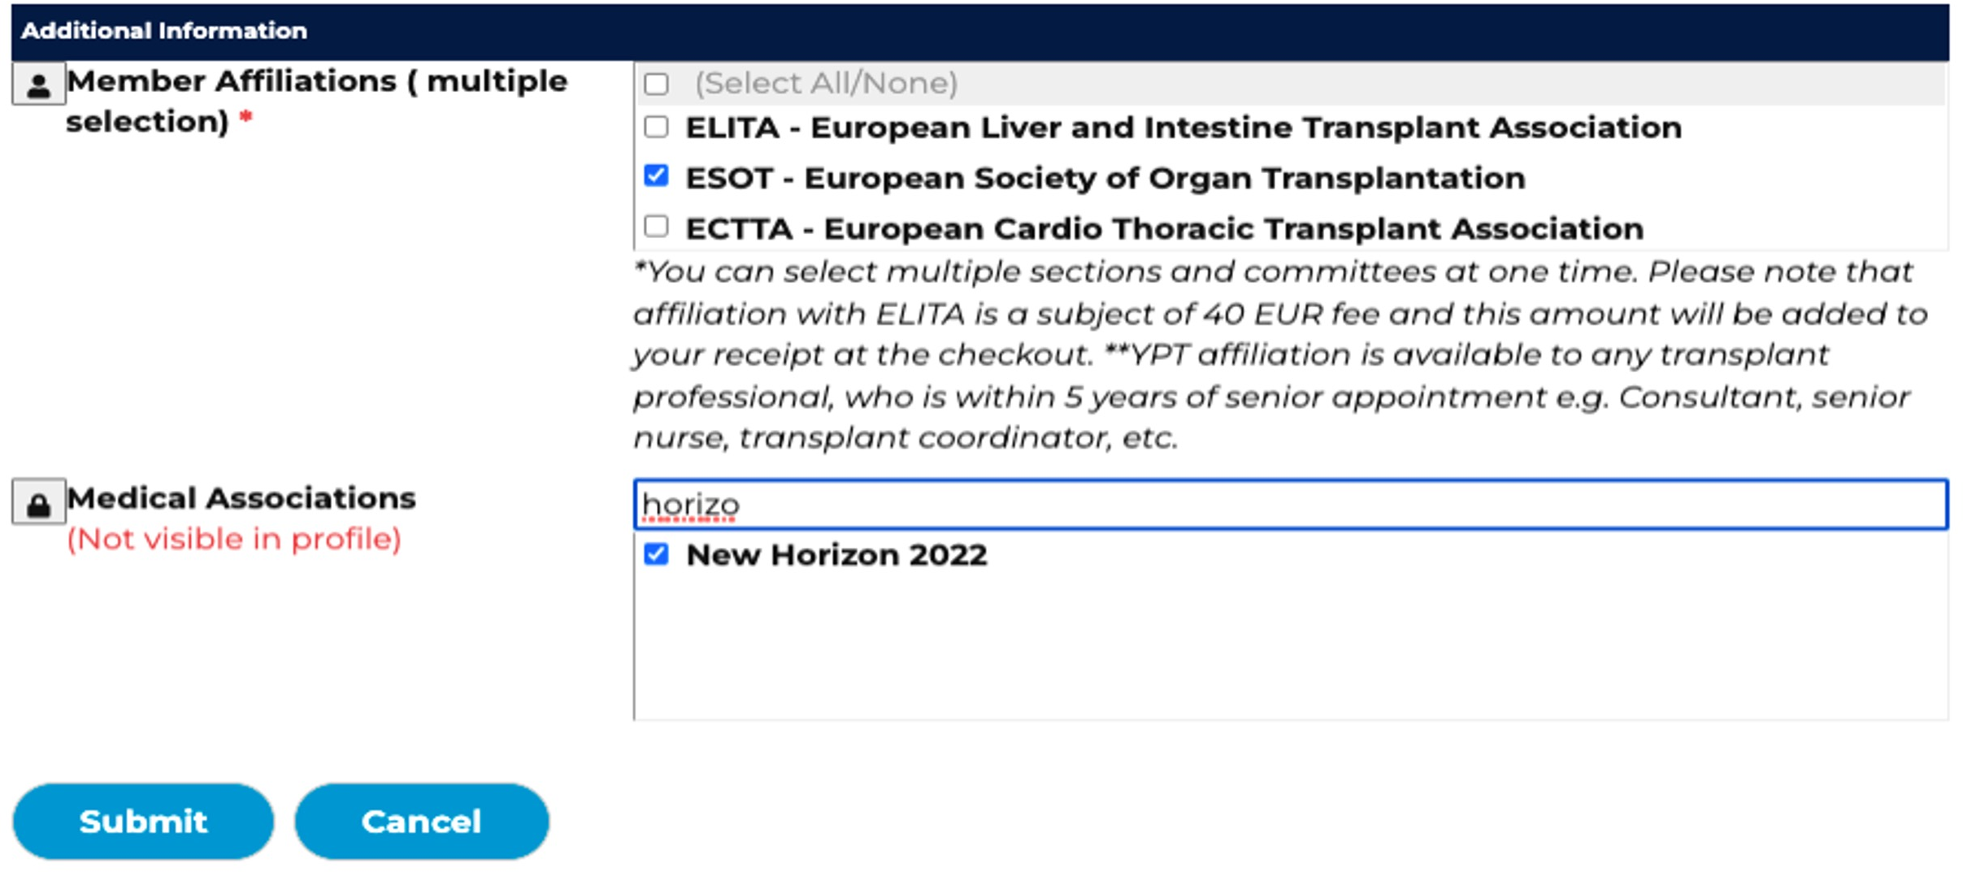

1. How to become a member and benefit from the discount
5. Fill in all members information.
Remember to add Your preferred affiliation as well as Your Medical association if you selected a Joint membership in Medical Associations information and click Submit.
EXAMPLE

Slide 8
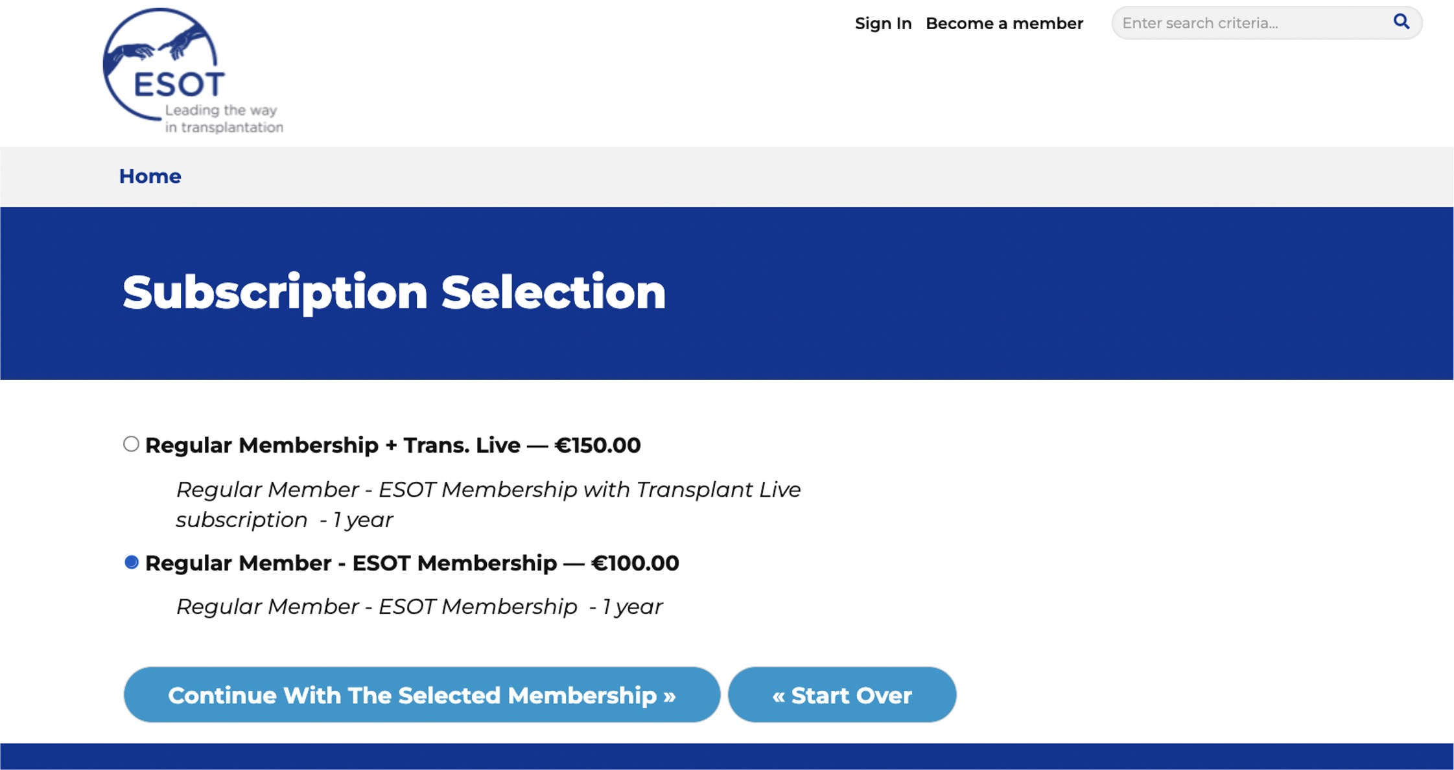
1. How to become a member and benefit from the discount
3. Select your membership: XX Membership and click on Continue
EXAMPLE

Slide 9
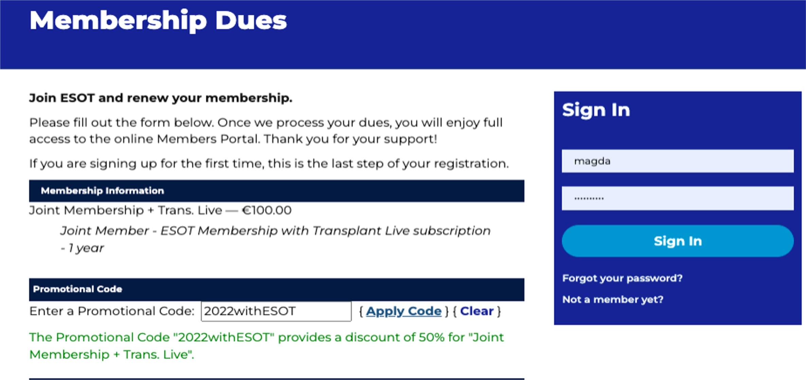
1. How to become a member and benefit from the discount
On the Membership Dues site – insert the promotional code: PROMOCODE [ESOT_ANBH_12m;
ESOT_yANBH_12mESOT_ANBHmember_12m]
6. Once applied – proceed with your selected method of payment - credit card or bank transfer and click on Submit on the bottom of the page to complete your subscription.
EXAMPLE
THE PROMOTIONAL CODE GRANTS YOU A 100% DISCOUNT ON THE SELECTED FEE

Slide 10
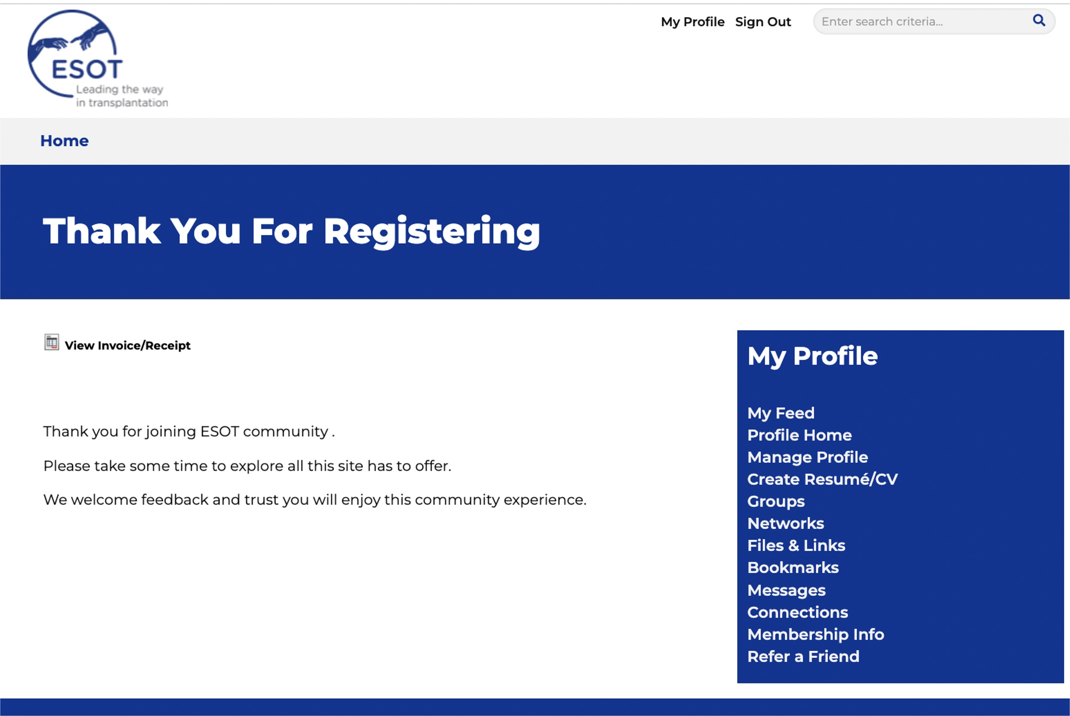
1. How to become a member and benefit from the discount

Slide 11
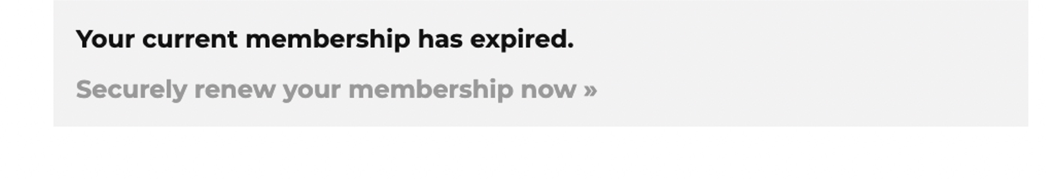
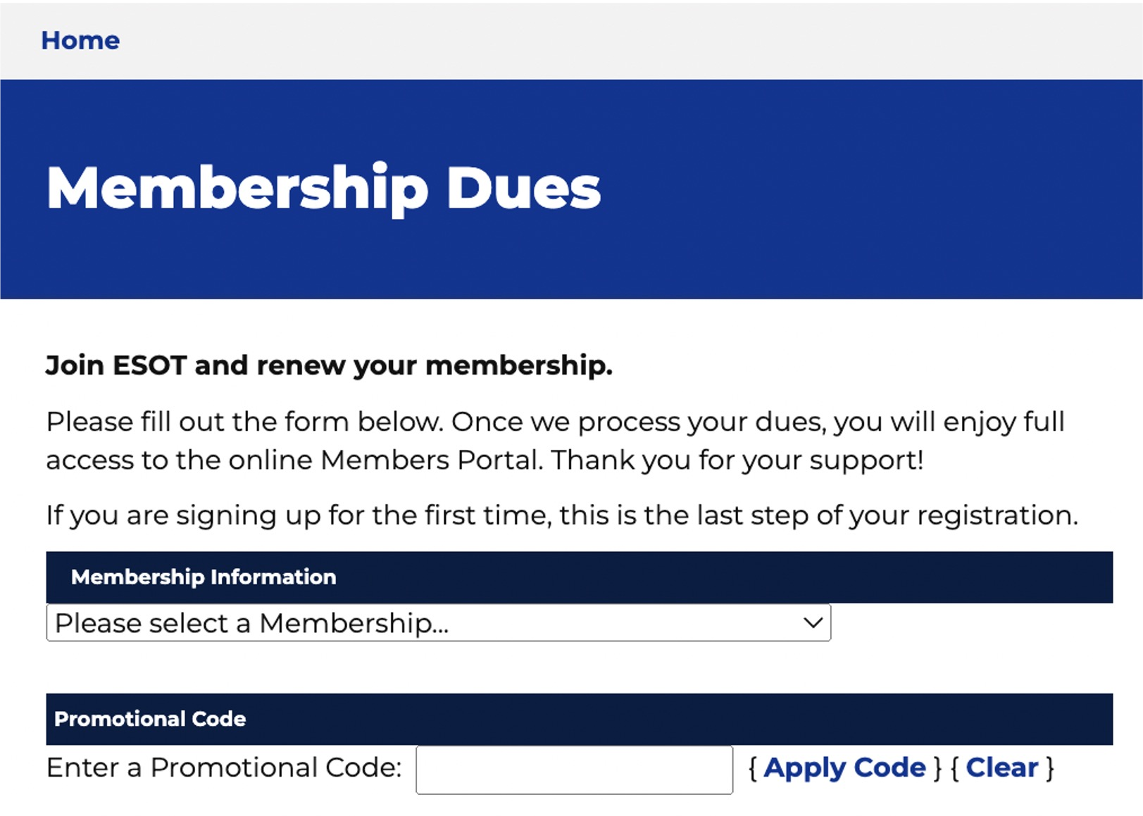
2. How to renew your membership and benefit from the discount

