Slide 1
PERITONEALNA DIJALIZA U BOSNI I HERCEGOVINI
Damir Rebić

Slide 2
Peritonealna dijaliza
Peritonealna dijaliza predstavlja jedan od načina liječenja bolesnika u terminalnoj fazi hronične bubrežne insuficijencije pored hemodijalize i transplantacije bubrega.
Kod ovih bolesnika važno je održavati:
adekvatan nutritivni status,
količinu tekućine u organizmu,
adekvatnu dijalizu u smislu procjene kvaliteta peritonealne membrane i
održavanje rezidualne bubrežne funkcije.
Pored ovoga, treba obratiti pažnju na odgovarajuće liječenje najznačajnije i najopasnije komplikacije ove dijalize – peritonitisa.
Koristiti trenutne smjernice objašnjene u vodičima za peritonealnu dijalizu
(ISPD 2020).

Slide 3
Istorija PD
1798g Vauquelin i Fourcroy, 1821g Prevost i Dumas, 1839g Christison - uočen podatak da su simptomi i znaci uremije posljedica akumulacije određenih supstanci u krvi i tkivima, prije svega uree
1861g Thomas Graham uvodi pojam „dijaliza“ u naučni riječnik
George Ganter 1923g uradio prvu IPD kod uremične pacijentice sa opstruktivnom nefropatijom zbog karcinoma uterusa uvodeći 1.5L slanog rastvora u trbušnu šupljinu kroz iglu koju je vadio nakon 3h i ponavljao proceduru svježom otopinom

Slide 4
Istorija PD
Poslije I svjetskog rata PD se primjenjivala pod nazivom „interna dijaliza“
U AKI prva PD urađena 1946g od strane Fine i saradnika iz Bostona
1950g uvode se prvi hloridni i polietilenski plastični kateteri u PD
1970 uvedeni prvi puta silikonski kateteri sa perforacijama na distalnom dijelu
1968 Tenckhoff dizajnirao kateter sa dva dakronska jastučića ili cuffa (kasnije modificiran sa zavijenim Palmerovim kateterom)
APD 1972 g uvodi prvi puta Tenckhoff
1976g CAPD Robert Popovich i Jack Moncrief (tzv. portabl / ekvilibrijum dijalizna tehnika)
Oreopoulos 1977g nova tehnika CAPD sa polivinil hloridnim vrećicama, sa savitljivim setom

Slide 5
Peritonealna dijaliza
1979 CAPD zvanično prihvaćena kao alternativa HD (Y set sistem; ANDY sistem sa dvije vrećice; Stay-Safe sistem; Clear-flix vrećice, polilefini-Biofine; jedna vrećica, dvije vrećice, prošivena vrećica sa 2 komore, standardne otopine, uravnotežene, bikarbonatne, nutritivne, icodextrin otopine)
APD 1981g uveden sa CCPD, CEPD; IAPD; NIPD
>300000 bolesnika se liječi PD
U svijetu Kanada 36%; Hong Kong 80%; Meksiko 81%
U SAD 2,28%, najveći postotak APD
Aseptic
Non-Touch Technique

Slide 6
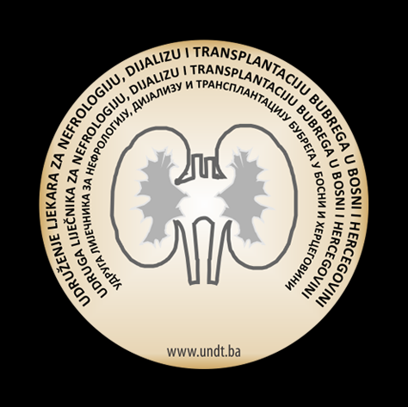
Nadomjesna bubrežna terapija
Najčešća renalna oboljenja u BiH koja uzrokuju hronično zatajenje bubrega: diabetes mellitus, hronični pijelonefritis, hronični glomerulonefritis, hipertenzija, .....
20,3% pacijenata - primarna bubrežna bolest je dijabetična nefropatija
Osnovni uzrok HBB u PD pts. diabetes melitus -32,0%
Kardiovaskularna oboljenja su, kao i kod HD pacijenata, najčešći uzrok smrti u PD pts.
Prva IPD u BiH u Tuzli 1969 g.-trovanje gljivama
Prva CAPD 1981g u KCUS

Slide 7
Peritonealna dijaliza
Trenutno u BiH 98 bolesnika na PD (u BiH 2001g 1,6%; trenutno 3,7%, u FBiH 5.5% - 86pts.; - KCUS 36pts)
APD 1pts. u RS; 2pts. u FBiH
U posljednjih 5 godina u BIH broj pacijenata na PD ima trend stagnacije i stalnog varijacije broja pacijenata
U 2009.godini je bio najveći broj pacijenata (108) a na dan 31.12.2019. godine ukupno je bio 103 pacijenta
Životna dob pacijenata je 45-64 godine (37.9% pts.)
 | 31.12. |  | Hemodijaliza |  |  | Peritonealna dijaliza |  | Graft funkcionalan |  |  |  | Ukupno
 |  |  | (N /%) |  |  | (N /%) |  | (N /%) |  |  |  | (N)
2002 |  | 1475 / 91,3% |  |  | 47 / 2,9% |  | 94 |  | / 5,8% |  | 1616
 | 2019 |  | 2207 / 81,9% |  |  | 103 / 3,8% |  | 384 | / 14,3% |  |  | 2694
X
√
√

Slide 8
Peritonealna dijaliza
Prednosti:
Redukcija kardiovaskularne nestabilnosti I aritmija
Bolje održavanje RRF
Bolja kontrola hipotenzije
Izostanak potrebe za vaskularnim pristupom
IP ordiniranje inzulina kod dijabetičara
Prezervacija cirkulatornog sistema
Mobilnost pacijenta
Cost benefit
Pogodan u dječijoj dobi
Nedostaci:
Peritonitis
Gubitak proteina dijaliznim efluentom
Infekcija tunela katetera
Nije preporučljiva kod ranijeg hirurškog otvaranja peritoneuma
Manja djelotvornost klirensa urea / kreatinin
Nije idealna metoda kod edema pluća

Slide 9
INTRODUCTION
SURVIVAL
GOAL- DIRECTED PD
REMOTE PATIENT MANAGEMENT
BRIDGE TO TRANSPLANT
SUMMARY
REFERENCES
ONLY
ON AVERAGE
12%
OF DIALYSIS PATIENTS
RECEIVE
PD
¹
TODAY
THERE IS A GROWING BODY OF
THAT SHOWS THAT
evidence
MODERN PD
has COMPARABLE or POTENTIALLY BETTER
CLINICAL OUTCOMES COMPARED TO
⁷⁻³⁴
HD
MODERN
FUNDAMENTALLY
COMPARED
is achieving
to how it was
PD
DIFFERENT RESULTS
HISTORICALLY DELIVERED
²⁻⁶
Notes:
Prosječno je samo 12% pacijenata na PD danas. Sve je više dokaza da je savremena PD kompatibilna ili čak i sa boljim klinički ishodima u odnosu na HD. Savremena PD daje bazično različite ishode u odnosu kako smo do sada imali.

Slide 10
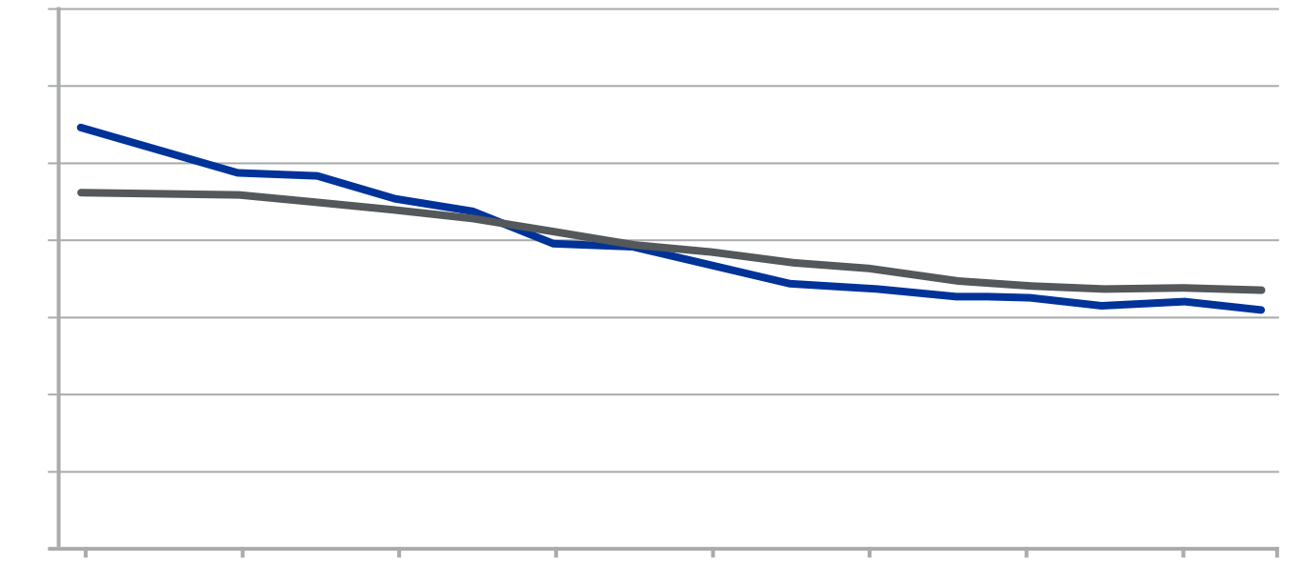
USRDS DATA SHOWS LOWER MORTALITY RISK FOR MODERN PD COMPARED TO HD
INTRODUCTION
SURVIVAL
GOAL- DIRECTED PD
REMOTE PATIENT MANAGEMENT
BRIDGE TO TRANSPLANT
SUMMARY
REFERENCES
350
300
HD
PD
250
200
Deaths Per 1,000 Patient-Years
150
100
50
0
2001
2003
2005
2007
2009
2011
2013
2015
2016
Year
USRDS-ESRD database has shown PD to have consistently better survival than HD since 2007⁵
USRDS ESRD Database. Adjusted for age, sex, race, ethnicity, primary diagnosis and vintage. Reference population: period prevalent ESRD patients, 2011.
Abbreviations: ESRD, end-stage renal disease; HD, hemodialysis; PD, peritoneal dialysis.
USRDS. United States Renal Data System. 2017 USRDS annual data report. Available from: https://www.usrds.org/adr.aspx.
Notes:
To potvrđuje ovaj slajd američkih podataka koji ukazuje na manju smrtnost PD u odnosu na HD pts. Počevši od 2007g

Slide 11
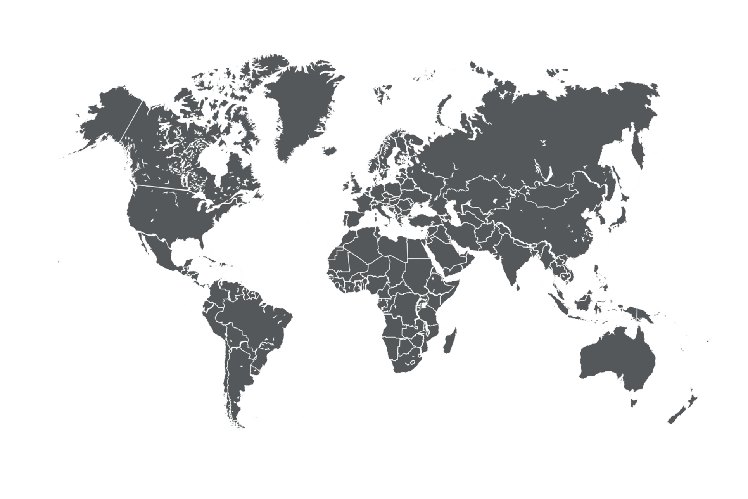
MULTIPLE STUDIES SHOW PD SURVIVAL RATES OUTPACING HD
INTRODUCTION
SURVIVAL
GOAL- DIRECTED PD
REMOTE PATIENT MANAGEMENT
BRIDGE TO TRANSPLANT
SUMMARY
REFERENCES
Canadian Organ Replacement Registry showed PD to historically have higher mortality risk compared to HD – however from 2000-4 the mortality risk equalized²
Danish Society Of Nephrology Registry has shown a consistent trend in improving PD mortality risk from 1990-2010³
Korean Society of Nephrology has shown an improvement of mortality risk of PD over HD since 2013⁴
USRDS-ESRD database has shown PD to have consistently better survival than HD since 2007⁵
ANZ Dialysis and Transplant Registry showed HD had a 23% improvement in mortality risk from 1998-2012 however PD showed a 29% improvement in mortality from 1998-2012⁶
Notes:
U svijetu, Kanađani prate izjednačenu smrtnost PD i HD pts, Danci poboljšavaju rezultate, amerikanci kao što sam rekao od 2007g prate bolji efekat preživljavanja pacijenata, kao i koreanci i austalija

Slide 12
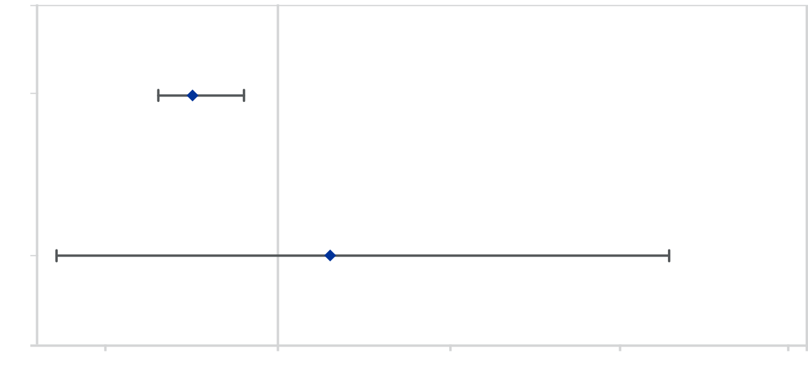
EARLY SURVIVAL BENEFIT RESULTS IN MORE PATIENT YEARS ON PD
INTRODUCTION
SURVIVAL
GOAL- DIRECTED PD
REMOTE PATIENT MANAGEMENT
BRIDGE TO TRANSPLANT
SUMMARY
REFERENCES
X
ERA-EDTA REGISTRY 2018 REPORT SHOWED A LOWER EARLY RISK OF DEATH FOR PD COMPARED TO HD³⁹
Hazard Ratio for PD mortality compared to HD = 0.95
(5% smaller death risk) (Confidence interval = 0.93-0.98)
Less than 3.5 years follow-up
Hazard Ratio for PD mortality compared the HD = 1.03
(3% higher death risk)
(Confidence interval = 0.87-1.23)
Total follow-up
.9
1
1.1
1.2
1.3
Hazard Ratio for Mortality PD Compared to HD (Point Estimate, 95% CI)
Adjusted for demographics and an extensive range of co-morbidity
Adapted from Kramer A., Pippias M., Noordzij M, Stel V., et al. Clinical Kidney Journal, Volume 11, Issue 1, February 2018, 108–122
Notes:
Grafika uspoređuje rizik od smrti kod PD, a standard je HD. Ovo je adaptirano iz publikacije jer je Kramer to izrazio obrnuto.
Na taj način, tijekom prvih 3,5 godine, omjer smrtnosti od PD iznosi 0,95 u odnosu na HD, što znači 5 posto manji rizik od smrti u PD nego u HD.
Interval pouzdanosti je 0,93 - 0,98 (srednja vrijednost 0,95).
Uobičajeni način da se to izrazi jest da je s 95% vjerojatnosti rizik od smrti kod PD nešto manje od 7% do manje od 2% nego kod HD.
Razlika je mala, ali značajna, jer cijeli interval pouzdanosti ostaje ispod 1,0.
Za ukupno praćenje omjer rizika je 1,03, što znači 3% veći rizik od PD u odnosu na HD, ali u ovom slučaju interval pouzdanosti kreće se od 0,87 (tj. 13% manji rizik kod PD) do 1,23 (23% veći rizik za PD). ).
Vodoravna crta intervala pouzdanosti prelazi vertikalnu crtu od 1,0 gdje su rizici jednaki za obje terapije.
Dakle, s 95% pouzdanosti ne može se reći da je PD bolji ili lošiji - a rezultat nije značajan.

Slide 13
INTRODUCTION
SURVIVAL
GOAL- DIRECTED PD
REMOTE PATIENT MANAGEMENT
BRIDGE TO TRANSPLANT
SUMMARY
REFERENCES
INTERNATIONAL SOCIETY FOR PERITONEAL DIALYSIS (ISPD) PRACTICE RECOMMENDATIONS
ADEQUACY
“Dialysis
“high-quality goal-directed
MOVE FROM
TO
IS NOT ENOUGH!
adequacy”
dialysis therapy.”
^{45,46}
Goal-directed dialysis
between the patient and care team
USES
shared decision-making
ISPD recommendations reflect the benefits of shared decision-making on
GOAL-DIRECTED PD is closely aligned with the core outcomes identified in the SONG*-PD INITIATIVE
PATIENT DIALYSIS TREATMENT SATISFACTION
⁴⁹
^{47,48}
*SONG: Standardized Outcomes in Nephrology
Notes:
ISPDprporučuje da adekvatnost nije sama dovoljna, već je potrebna visokokvalitetna dijaliza usmjerena ka cilju , što podrazumjeva zajedničku odluku između pacijenata i kliničara, da bi tretman dobio svoju satisfakciju, što je jasno prikazano u tzv SONG PD inicijativi

Slide 14
PD OFFERS PATIENTS INDEPENDENCE AND CONTROL OF THEIR THERAPY
INTRODUCTION
SURVIVAL
GOAL- DIRECTED PD
REMOTE PATIENT MANAGEMENT
BRIDGE TO TRANSPLANT
SUMMARY
REFERENCES
Lifestyle-related domains of HRQoL are reported to be better with PD vs HD¹⁷⁻²³
PORTABILITY
CONTINUED DAILY ACTIVITIES^{41,42,52}
So patients can continue to travel
APD may be performed while sleeping, so patients can work or attend school full-time
⁵³
⁵⁴
REDUCED CLINIC VISITS
LOWER CAREGIVER BURDEN
Visits every 4-12 weeks vs 3-4 times per week
35% of PD patients with low levels of caregiver burden vs 13% of HD patients
HRQoL: Health-related quality of life
GLBL/MG2/18-0010b 10/18
Notes:
PD nudi veću neovisnost i kontrolu nad terapijom pacijenta, bolju mobilnost, promjenu životniog stila i aktivnosti, manje posjeta klinikama i na kraju za 35% manju potrebu za tzv njegovateljima
(Francois 2014) narrative review of the benefits of PD.
(Muehrer 2011) Retrospective study of USRDS to determine association of employment status with dialysis initiation from 1992 to 2003
(Kutner 2010) Comprehensive Dialysis Study (CDS), a prospective cohort study conducted by USRDS of patients with ESRD to evaluate factors contributing to physical, functional, and nutritional health status of patients starting diaylsis

Slide 15
MODERN PD CAN SUPPORT KIDNEY TRANSPLANT GOALS
INTRODUCTION
SURVIVAL
GOAL- DIRECTED PD
REMOTE PATIENT MANAGEMENT
BRIDGE TO TRANSPLANT
SUMMARY
REFERENCES
POST-TRANSPLANT OUTCOMES, INCLUDING SURVIVAL, ARE SIMILAR OR BETTER IN PD PATIENTS THAN IN HD PATIENTS
Post-transplant mortality (PD relative to HD) | Joachim 2018⁵⁸ | 0.89 | 0.82, 0.97 | Lower post-transplant mortality with PD
Post-transplant mortality (PD relative to HD) | Tang 2016⁵⁹ | 0.86 | 0.97, 0.95 | Lower post-transplant mortality with PD
Delayed graft function | Joachim 2018 | 0.50 | 0.41, 0.63 | Better early graft function with PD
(PD relative to HD) | Tang 2016 | 0.67 | 0.62, 0.74 | Better early graft function with PD
Delayed graft function | Joachim 2018 | 0.97 | 0.92, 1.01 | Trend to better post- transplant graft survival
Notes:
Sustavni pregled literature i metaanaliza 16 studija procjenjivali su smrtnost nakon transplantacije, preživljavanje grafta ili odgođenu funkciju grafta u bolesnika koji su primali HD ili PD prije transplantacije (Joachim 2017):
Pacijenti koji su primali PD prije transplantacije imali su značajno bolju smrtnost i funkciju kalemljenja od HD prije transplantacije
Vrlo slična otkrića primijećena su u zasebnoj metaanalizi 12 studija
PD prije transplantacije značajno je povezan s nižom 5-godišnjom smrtnošću nakon transplantacije u usporedbi s HD
Iako nije bilo značajne razlike u stopi preživljavanja grafta, pacijenti s PD prije transplantacije imali su nižu učestalost odgođene funkcije graftaA systematic literature review and meta-analysis of 16 studies assessed post-transplant mortality, graft survival, or delayed graft function in patients receiving HD or PD pre-transplant (Joachim 2017):
Patients who received pre-transplant PD had significantly better mortality and graft function than pre-transplant HD
Very similar findings were observed in a separate meta-analysis of 12 studies
Pre-transplant PD was significantly associated with lower 5-year mortality post-transplant compared with HD
While there was no significant difference in the graft survival rate, pre-transplant PD patients had a lower incidence of delayed graft function

Slide 16
MODERN PD IN SUMMARY
INTRODUCTION
SURVIVAL
GOAL- DIRECTED PD
REMOTE PATIENT MANAGEMENT
BRIDGE TO TRANSPLANT
SUMMARY
REFERENCES
Modern PD has improved dramatically over the last 10 years, and outcomes are now equivalent to – or even outpacing – those of HD
Modern PD is achieving fundamentally different results compared to how it was historically delivered
Studies around the world show lower mortality risk of modern PD compared to HD
Modern PD has a marked early survival benefit and more patients stay alive longer on PD
PD has better quality of life enabling patients to live well
Modern PD can facilitate kidney transplantation
Notes:
Suvremeni PD dramatično se poboljšao tijekom posljednjih 10 godina, a ishodi su sada jednaki - ili čak bolji od HD-a
Suvremeni PD postiže bitno drugačije rezultate u odnosu na to kako je povijesno isporučen
Studije širom svijeta pokazuju niži rizik od smrtnosti suvremenih PD u odnosu na HD
Suvremeni PD ima značajnu korist za rano preživljavanje i više pacijenata ostaje dulje na životu na PD
PD ima bolju kvalitetu života omogućavajući pacijentima da dobro žive
Suvremeni PD može olakšati transplantaciju bubrega

Slide 17
INTRODUCTION
CONTRA- INDICATIONS
LIVING FULLY & COMFORTABLY
PATIENT SELECTION
SHARED DECISION-MAKING
SUMMARY
REFERENCES
78%
have no absolute medical or social contraindication for
AT LEAST
This includes elderly & diabetic patients who are often excluded from
PD
PD
^{1,2}
^{3,4}
OF PATIENTS
SHARED DECISION MAKING
It is a collaborative & iterative process where the clinician
SUPPORTS THE PATIENT TO REACH A TREATMENT DECISION THAT IS RIGHT FOR THEM
is an emerging standard health practice for patients
Notes:
Zajedničko donošenje odluka (SDM) osigurava potporu pojedincima u donošenju odluka koje odgovaraju njima. To je suradnički postupak kroz koji kliničar podržava pacijenta u donošenju odluke o njegovom liječenju. ... stručnost kliničara, poput mogućnosti liječenja, dokaza, rizika i koristi
Shared decision making (SDM) ensures that individuals are supported to make decisions that are right for them. It is a collaborative process through which a clinician supports a patient to reach a decision about their treatment. ... the clinician's expertise, such as treatment options, evidence, risks and benefits.

Slide 18
INTRODUCTION
CONTRA- INDICATIONS
LIVING FULLY & COMFORTABLY
PATIENT SELECTION
SHARED DECISION-MAKING
SUMMARY
REFERENCES
78%
have no absolute medical or social contraindication for
This indicates that the therapy should be considered for a wide range of patients
PD
OF PATIENTS
^{1,2}
with ESRD
ABSOLUTE
Patients who have lost peritoneal membrane function
Patients with abdominal defects or abnormalities that prevent effective fluid and solute removal or increase the risk of infection
Settings where the patient and caregiver are either unable or unwilling to perform the therapy
contraindications
PD
for
are present in only a SMALL
PROPORTION OF ESRD patients^{1,2}
Notes:
Pacijenti koji su izgubili funkciju peritonealne membrane
Pacijenti s abdominalnim oštećenjima ili abnormalnostima koje sprečavaju učinkovito uklanjanje tekućine i otopljene tvari ili povećavaju rizik od infekcije
Postavke u kojima pacijent i njegovatelj ili ne mogu ili ne žele provesti terapiju

Slide 19
INTRODUCTION
A COMMON PROBLEM
URGENT- START PD
CATHETER INSERTION
SUMMARY
REFERENCES
70%
URGENT-START
is a very common problem:
up to
of dialysis patients may
START DIALYSIS
in an
UNPLANNED
way
¹⁻¹⁰
STARTING DIALYSIS in an UNPLANNED WAY, means PATIENTS may not have an OPPORTUNITY for MODALITY CHOICE
PD
HD
URGENT-START
is associated with better outcomes when starting with
THEN
¹³⁻¹⁸
DIALYSIS

Slide 20
INTRODUCTION
A COMMON PROBLEM
URGENT- START PD
CATHETER INSERTION
SUMMARY
REFERENCES
X
PD CATHETER CAN BE ESTABLISHED AND USED IMMEDIATELY AND FOR LONG-TERM TREATMENT¹¹
Patient: Urgent Start Dialysis
Modality Selection
Peritoneal Dialysis
Hemodialysis
Dual*
PD Catheter Placement (permanent)
HD Vascular Access (tunnelled or non-tunnelled)
Acute HD Vascular Access (temporary)
In-Clinic PD
Inpatient/Outpatient HD
In-Hospital HD
At-Home PD
Permanent Access Placed
Place PD catheter and follow steps in PD pathway
*Dual = urgent HD for 2 sessions followed by PD
Schreiber Jr MJ. Semin Dial Vol 30, 2017 149–157

Slide 21
URGENT-START SUMMARY
INTRODUCTION
A COMMON PROBLEM
URGENT- START PD
CATHETER INSERTION
SUMMARY
REFERENCES
Urgent-start is a common problem
A PD catheter can be established and used immediately and for long-term treatment
Urgent-start dialysis is associated with better outcomes when starting with PD compared with HD
Developing a ward-based education and Shared Decision-Making model can provide urgent-start patients with the same treatment options as a planned-start patient
Access barriers can be overcome by nephrologists leading catheter insertion programs with a subsequent increase in PD patients
Notes:
Hitni početak je čest problem
PD kateter se može uspostaviti i koristiti odmah i za dugotrajno liječenje
Dijaliza s hitnim početkom povezana je s boljim ishodima kada se započne s PD u usporedbi s HD-om
Razvijanje obrazovanja na odjelu i modela zajedničkog odlučivanja može pružiti pacijentima s hitnim početkom iste mogućnosti liječenja kao i pacijentima s planiranim početkom liječenja
Pristupne zapreke mogu nadvladati nefrolozi koji vode programe uvođenja katetera s naknadnim povećanjem broja pacijenata s PD

Slide 22
THE CHALLENGES OF DIALYZING PATIENTS DURING A PANDEMIC: DIALYSIS PATIENTS ARE VULNERABLE
THE CHALLENGES
STAY HOME TO DIALYZE
IMPLEMENTING PD
A PARADIGM SHIFT
SUMMARY
REFERENCES
MOST (IF NOT ALL)
DIALYSIS PATIENTS
DIALYSIS PATIENTS
are
MORE PRONE TO DEVELOP
are IMMUNOCOMPROMISED and a HIGH-RISK POPULATION for contracting viral infections
SEVERE INFECTIOUS DISEASES
VS
THE GENERAL POPULATION
¹
RISK
HEMODIALYSIS PATIENTS,
CHRONIC DIALYSIS
is an
are >60% MORE LIKELY to be infected with COVID-19 – increased risk due to the PROXIMITY of dialyzing with
others and FREQUENCY of in-center dialysis²
ESSENTIAL, LIFE-SUSTAINING THERAPY for millions of patients around the world: KEEPING PATIENTS SAFE during a pandemic IS PARAMOUNT
2-3 HD/week

Slide 23
THE CHALLENGES OF MANAGING AN HD CLINIC DURING A PANDEMIC: MANAGING AND PROTECTING HEALTHCARE RESOURCES
THE CHALLENGES
STAY HOME TO DIALYZE
IMPLEMENTING PD
A PARADIGM SHIFT
SUMMARY
REFERENCES
PANDEMICS force HD CENTERS
INCREASED SCREENING
PPE
to implement a host of new safety procedures to protect patients and staff¹
TRIAGING
DISINFECTION PROTOCOLS
ISOLATION
SOCIAL DISTANCING
PANDEMICS place
STRAIN
WHO HAVE LOST
MANPOWER TO ILLNESS & QUARANTINE
ON THE
CLINICAL TEAM
AKI requiring RRT develops
placing a tremendous burden on dialysis clinics
DEMAND MAY EXCEED CAPACITY³
in 20% to 30%
of COVID-19 ICU PATIENTS,

Slide 24
DIALYSIS AT HOME IS THE PREFERRED OPTION:¹ MINIMIZING HOSPITAL VISITS
THE CHALLENGES
STAY HOME TO DIALYZE
IMPLEMENTING PD
A PARADIGM SHIFT
SUMMARY
REFERENCES
HOME DIALYSIS
can provide
Patients who must start dialysis during the pandemic should receive therapy at home. This includes urgent start patients¹
LIFE-SUSTAINING THERAPY
PATIENT SAFETY
while reducing the risk of exposure to viral infections by minimizing visits to the dialysis facility¹
STAY HOME
DECREASING DIALYSIS NURSE EXPOSURE
ENSURING QUALITY OF CARE
~80%
OF PATIENTS ARE MEDICALLY ELIGIBLE FOR PD⁷
NURSING SAFETY
to patients with COVID-19 as a STRATEGY TO PRESERVE THE WORKFORCE
Consider PD FIRST for both PLANNED & URGENT START PATIENTS
TELEMEDICINE AND ADVANCES IN REMOTE PD MONITORING
have been PARAMOUNT in MANAGING PD PATIENTS REMOTELY⁸.

Slide 25
THE CHALLENGES
STAY HOME TO DIALYZE
IMPLEMENTING PD
A PARADIGM SHIFT
SUMMARY
REFERENCES
HOW TO IMPLEMENT PD DURING A PANDEMIC USE REMOTE PATIENT MANAGEMENT (RPM) TO MINIMIZE FACE-TO-FACE INTERACTION
RPM is a SAFE AND EFFECTIVE way to manage patients^{8,16}
PD patients should be assisted at home as far as is possible, using telereporting assistance or other electronic systems for clinical management and to supplement home visits by healthcare staff, as deemed necessary.¹⁷
According to a survey of the Italian Society of Nephrology, the proportion of patients positive for SARS-CoV-2 was significantly higher in HD than PD telemedicine/remote consulting might have contributed to reduce the risks.²
Where available, remote monitoring (e.g. Sharesource) would be utilized to support communication and streamline staff working.⁹
Remote patient management (RPM) should be strongly recommended as the major way to manage patients on PD.¹⁸
Sharesource enables pro-active and personalized PD therapy to improve outcomes
Sharesource: Real-world examples
Notes:
KAKO IMPLEMENTIRATI PD ZA VRIJEME PANDEMIJSKE UPOTREBE DALJINSKOG UPRAVLJANJA BOLESNICIMA (O / min) ZA MINIMIRANJE INTERAKCIJE LICE-U-LICE
1.Pacijentima s PD treba pružiti pomoć kod kuće što je više moguće, koristeći pomoć za daljinsko izvještavanje ili druge elektroničke sustave za kliničko vođenje i dopunjavanje kućnih posjeta zdravstvenog osoblja, ako se to smatra potrebnim
2. Prema istraživanju Talijanskog društva za nefrologiju, udio pacijenata pozitivnih na SARS-CoV-2 bio je značajno veći u HD-u nego što je PD telemedicina / daljinsko savjetovanje moglo doprinijeti smanjenju rizika
3. Gdje je dostupno, daljinsko nadgledanje (npr. Sharesource) koristilo bi se za potporu komunikaciji i pojednostavljivanje rada osoblja
4. Daljinsko upravljanje pacijentima (RPM) treba se snažno preporučiti kao glavni način upravljanja pacijentima s PD

Slide 26
THE CHALLENGES
STAY HOME TO DIALYZE
IMPLEMENTING PD
A PARADIGM SHIFT
SUMMARY
REFERENCES
HOW TO IMPLEMENT PD DURING A PANDEMIC THE OPTION OF PD IN THE ICU FOR THE MANAGEMENT OF AKI
Preliminary data have shown that about 20-30% of hospitalized COVID-19 patients develop kidney failure, leading to a surge in requirement for dialysis⁵
While CRRT is the preferred therapy, ISPD RECOGNIZES PD AS AN ACCEPTABLE MODALITY TO TREAT AKI if CRRT capacity is limited, with recent studies showing outcomes comparable to CRRT²⁸
CRRT
PD
N/A
Despite increased abdominal pressure, PD DOES NOT APPEAR TO WORSEN RESPIRATORY MECHANICS in AKI patients²⁹
LATERAL EXIT-SITE CATHETER PLACEMENT should be considered to allow patients with ARDS to be placed in the prone position

Slide 27
COVID-19 SAFETY SUMMARY
THE CHALLENGES
STAY HOME TO DIALYZE
IMPLEMENTING PD
A PARADIGM SHIFT
SUMMARY
REFERENCES
Pandemics pose numerous challenges for both dialysis patients and clinics
Dialysis patients are particularly vulnerable to COVID-19 vs the general population
In-center hemodialysis puts dialysis patients and staff at risk of infection
New safety procedures and sharply increased demand place a tremendous burden on dialysis clinics
Home therapy with PD should be prioritized
Home dialysis with PD reduces the risk of infection and the risk to clinical staff
Catheter placement should be deemed essential, not elective surgery
Remote Patient Management (RPM) with Sharesource should be utilized to ensure quality of care while minimizing face-to-face interaction
PD is an acceptable alternative to CRRT to treat AKI and does not appear to impact respiratory mechanics
COVID-19 will likely result in a paradigm shift towards increased home dialysis with PD and RPM
Notes:
Pandemije predstavljaju brojne izazove i dijaliznim pacijentima i klinikama
Pacijenti na dijalizi posebno su osjetljivi na COVID-19 u odnosu na opću populaciju
Hemodijaliza u centru izlaže dijalizne bolesnike i osoblje riziku od zaraze
Novi sigurnosni postupci i naglo povećana potražnja stvaraju strašan teret dijaliznim klinikama
Kućna terapija s PD treba imati prioritet
Kućna dijaliza s PD smanjuje rizik od infekcije i rizik za kliničko osoblje
Postavljanje katetera trebalo bi smatrati ključnim, a ne elektivnom operacijom
Daljinsko upravljanje pacijentima (RPM) s Sharesourceom trebalo bi koristiti kako bi se osigurala kvaliteta njege uz minimaliziranje interakcije licem u lice
PD je prihvatljiva alternativa CRRT-u za liječenje AKI-a i čini se da ne utječe na respiratornu mehaniku
COVID-19 vjerojatno će rezultirati promjenom paradigme prema povećanoj kućnoj dijalizi s PD i RPM

Slide 28
ISPD
Dijaliza kod kuće
Daljinsko (wi-fi) upravljanje pacijentima
Razmotriti PD, uključujući akutni početak liječenja uremije
CAPD za nove pacijente
Posebno važno gdje preostala bubrežna funkcija (ISPD smjernice)
Mjere predostrožnosti prilikom odlaganja otpadnih PD tekućina i korištenih plastičnih vrećica

Slide 29
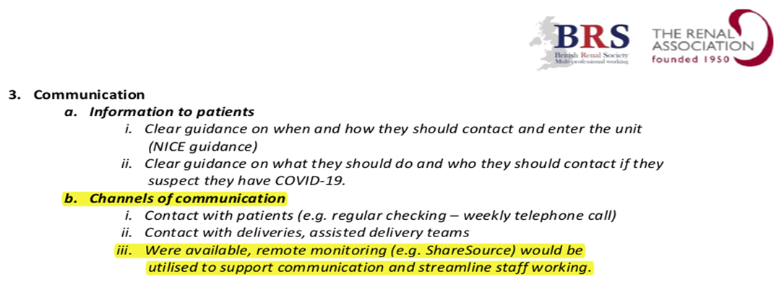
British Renal Association COVID-19: Checklist and Guidance for management of Peritoneal Dialysis Programmes
Dijaliza kod kuće kao preferirana opcija
Regionalno umrežavanje
Komunikacija
Podrška pacijentu
Kadroviranje
Trening
Ambulantno upravljanje
Dijalizna preskripcija i liječenje dijalizom
PD opskrba, isporuka i odlaganje tekućine
Testiranje PPE i antitijela
Upravljanje komplikacijama PD, uključujući infekciju povezanu s PD

Slide 30
Otopine
Type | Na⁺ | K ⁺ | Ca⁺⁺ | Mg⁺⁺ | Cl⁻ | HCO3⁻ | lactate | pH | osm.
Fresenius™ Balance 1.5% | 134 |  | 1.25 | 0.5 | 100.5 |  | 35 | 7.0 | 356
Baxter™ Dianeal 1.5% | 132 |  | 1.25 | 0.25 | 95 |  | 40 | 5.2 | 344
Baxter™ Physioneal 1.5% | 132 |  | 1.75 | 0.25 | 101 | 25 | 10 | 7.5 | 345
Fresenius ™ Bicavera 1.5% | 134 |  | 1.75 | 0.5 | 104.5 | 34 |  | 7.4 | 358
Physioneal solution Physioneal is a bicarbonate/lactate-buffered PD solution with a neutral pH,¹ which helps to reduce infusion pain² and may help to preserve residual renal function and increase urine volume,³ compared with conventional PD solutions
Extraneal solution Extraneal (icodextrin) PD solution may be associated with improved patient survival¹ and may extend time on therapy,^{2,3} with potential cost savings,² compared with non-icodextrin-based solutions. Extraneal is the only globally commercially available icodextrin PD solution^{4,5,a}
Nutrineal solution Nutrineal (1.1% amino acid) PD solution can support PD patient metabolism by improving protein synthesis and nitrogen balance^{1–6} and help to avoid peritoneal membrane glucose exposure^{7,8}

Slide 31
APPLYING MODERN PD TO BENEFIT YOUR DIALYSHVALA NA PAŽNJI
IS PATIENTS
Tuzla, 29.5.2021.
GLBL-MG2-19-0025a

