Slide 1
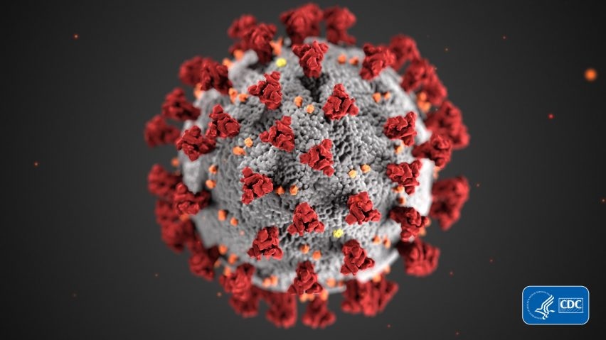
COVID-19
AND KIDNEY DISEASE

Slide 2

WHO WE ARE
EKHA aims at advocating for kidney patients’ needs and the nephrological community at EU and national level.
Its membership brings together:
Physicians
Nurses
Patients
Foundations

Slide 3
CHRONIC KIDNEY DISEASE (CKD) BURDEN

Slide 4

WHO SUFFERS FROM CKD?
Notes:
If we take 10 Europeans…

Slide 5

WHO SUFFERS FROM CKD?
Notes:
One suffers from CKD. Which means almost 75 million Europeans suffer from CKD

Slide 6
WHO SUFFERS FROM CKD?
More than 75 million Europeans suffer from CKD!
Notes:
One suffers from CKD. Which means almost 75 million Europeans suffer from CKD

Slide 7
WHO SUFFERS FROM CKD?
One in 3 is at risk of CKD!
Notes:
One suffers from CKD. Which means almost 75 million Europeans suffer from CKD

Slide 8
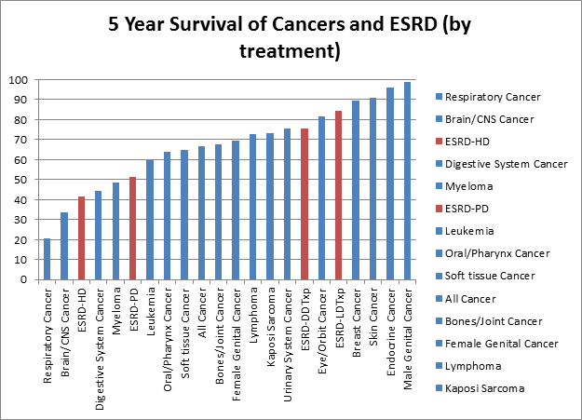
SURVIVAL OF HD IS WORSE THAN THAT OF CANCERS

Slide 9
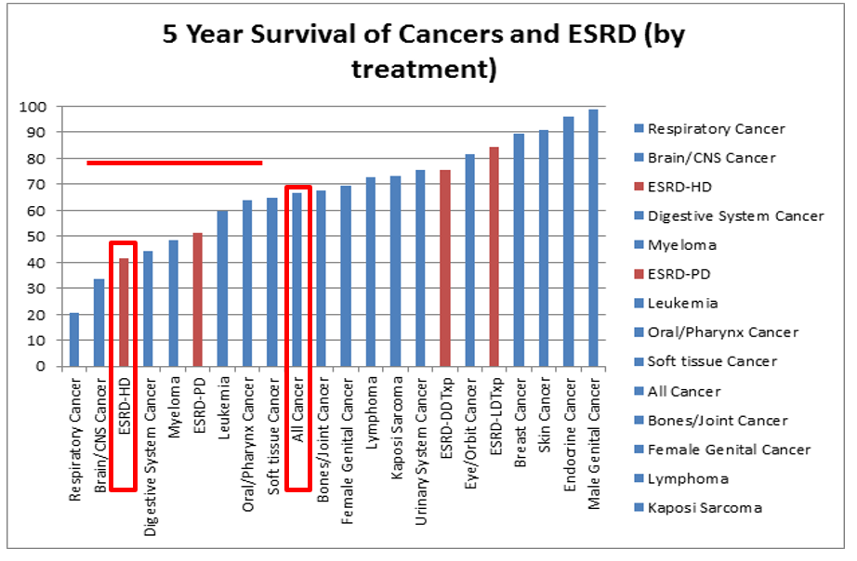
SURVIVAL OF HD IS WORSE THAN THAT OF CANCERS
YEARLY COST OF CKD AND CANCER IS THE SAME

Slide 10
HEALTH CARE COSTS CANCER AND CKD ARE OF THE SAME ORDER
Van der Tol at al, NDT, doi: 10.1093/ndt/gfaa035; Mohnen et al, Plos One, 34, e0220800, 2019; Kerr et al, NDT, 27 Suppl 3, iii73-80, 2012; Kerr et al, NDT, 29, 1362-8, 2014; Hofmarcher et al, Eur J Cancer, 129, 41-49, 2020
,
Notes:
Correction for TP and CKD. Correction for CKD 2.79

Slide 11
COVID-19 & KIDNEY DISEASE

Slide 12
KIDNEY DISEASE: ORIGINALLY NEGLECTED
 | ALL PATIENTS (N=1099) | NONSEVERE (926) | SEVERE (173)
Chronic Kidney Disease | 8 (0.7%) | 5 (0.5%) | 3 (1.7%)
Renal Replacement Therapy | 9 (0.8%) | 0 | 9 (5.2%)
Guan at al, NEJM, 382, 1708-1720, 2020

Slide 13
COVID-19: ADMISSION IN HOSPITAL AND ON ICU
HOSPITAL
ICU
CDC (US) data

Slide 14
HIGH MORTALITY IN HD AND TRANSPLANTATION
Jager et al, KI, in press (ERA-EDTA registry data)

Slide 15
PD: RISK LOWER
Quintaliani et al, J Nephrol, 33:725–736, 2020

Slide 16
RISK OF ACUTE KIDNEY INJURY
1993 of 3456 hospitalised patients (57.6%) developed AKI
694 of 1993 AKI patients died (34.8%)
Hirsch et al, KI, doi: 10.1016/j.kint.2020.05.006

Slide 17

RISK OF DIALYSIS SHORTAGES
NEW YORK CITY/ SHORTAGE DIALYSIS MATERIAL

Slide 18
RISK OF PPE SHORTAGES
PPE SHORTAGES OCCURED IN MANY PLACES

Slide 19
KIDNEY PROBLEMS WITH
COVID-19 (1)
CKD patients are more susceptible and have worse outcomes
Outbreaks in HD-centers (closed community)
Immunosuppressed patients are more susceptible and have worse outcomes
Decrease in transplantation rates
High risk of AKI
Notes:
Ook JAMA open initial characteristics.

Slide 20
KIDNEY PROBLEMS WITH
COVID-19 (1)
CKD patients are more susceptible and have worse outcomes
Outbreaks in HD-centers (closed community)
Immunosuppressed patients are more susceptible and have worse outcomes
Decrease in transplantation rates
High risk of AKI
Notes:
Ook JAMA open initial characteristics.

Slide 21
KIDNEY PROBLEMS WITH COVID-19 (2)
PD catheter insertions postponed
High need for technological material
Lack of protective material
Personnel: close contact with patients and infecton risk
Drop-out and burn-out personnel
Exclusion kidney patients from therapeutic studies

Slide 22
KIDNEY PROBLEMS WITH COVID-19 (2)
PD catheter insertions postponed
High need for technological material
Lack of protective material
Personnel: close contact with patients and infecton risk
Drop-out and burn-out personnel
Exclusion kidney patients from therapeutic studies

Slide 23
KIDNEY PROBLEMS WITH COVID-19 (2)
PD catheter insertions postponed
High need for technological material
Lack of protective material
Personnel: close contact with patients and infecton risk
Drop-out and burn-out personnel
Exclusion kidney patients from therapeutic studies

Slide 24
KIDNEY PROBLEMS WITH COVID-19 (2)
PD catheter insertions postponed
High need for technological material
Lack of protective material
Personnel: close contact with patients and infecton risk
Drop-out and burn-out personnel
Exclusion kidney patients from therapeutic studies

Slide 25
BACK-UPS

Slide 26
HOME DIALYSIS: 40% LESS DEATHS
Couchoud et al, KI, in press

Slide 27
HEALTH CARE COSTS CA AND CKD OF THE SAME ORDER
Van der Tol at al, NDT, doi: 10.1093/ndt/gfaa035; Mohnen et al, Plos One, 34, e0220800, 2019; Kerr et al, NDT, 27 Suppl 3, iii73-80, 2012; Kerr et al, NDT, 29, 1362-8, 2014; Hofmarcher et al, Eur J Cancer, 129, 41-49, 2020
,
Notes:
80,5 Cost in total CKD, but there is also AKI (continuum with CKD); only 27% of CKF cost is needed to bring it to the same level as cancer, but it is not 27% but 300% according to Kerr

Slide 28
DIALYSIS PATIENTS: 21% DEATHS
Couchoud et al, KI, in press

