Slide 1
Acute kidney injury in bosnia and herzegovina
Enisa Mesic
UKC Tuzla
CME Sarajevo, September 16-18 2016.

Slide 2
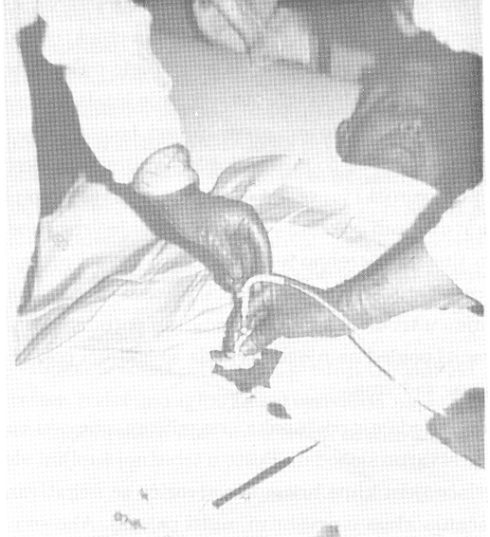
Before 1992
No data about prevalence and incidence
No available published papers
IPD in the treatments of:
Acute exacerbation in the patients with CKD, BEN most frequently
Acute exogenous poisonings (Amanita phaloides)
Sepsis

Slide 3
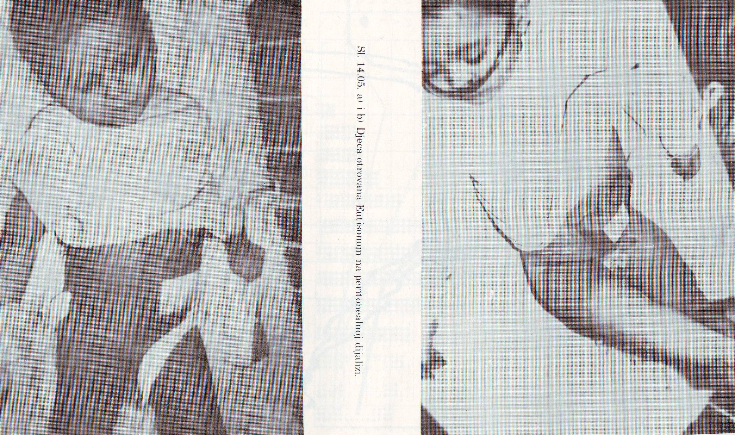
Three chiildren (18-36 months) with overdosing of isoniazid (2400 mg) during treatment of meningitis 1976.

Slide 4
Sepsis
Crime abortion, 1977

Slide 5
PD in DC Tuzla

Slide 6
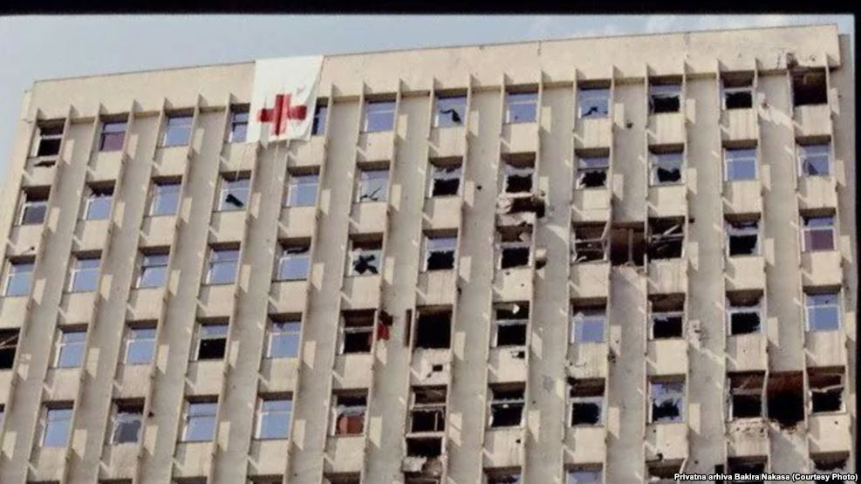
Bosnian War 1992-1995

Slide 7
Bosnian War 1992-1995
During the Bosnian war (1992-1995) we had no opportunity to research, but we recorded data about our chronic and acute kidney patients.
Very limited results were published in English language in the journals available to nephrology community.
Smith and colleagues published systematic literature review of the quality of evidence for injury and rehabilitation interventions in humanitarian crises. They found 46 papers which met the inclusion criteria, 63% of the papers referred to situation of armed conflict, of which the Yugoslav Wars were the most studied crisis context. However, only two studies were considered of a high quality (Smith, 2015).

Slide 8
Bosnian War 1992-1995
After dissolution of Yugoslavia in the beginning of 90-ties, the most intensive and cruel war occurred in B&H with a lot of civil and soldiers casualties. It was estimated that around 100000 people were killed, 300000 wounded and mutilated and two million became refugees during the 1992-1995 war (Simunovic, 2007).
Country was divided into three parts and medical organization was broken. Some parts of B&H were in complete communication and transport blockade. Number of medical personnel left hospitals. In these circumstances we had to organize HD therapy for chronic patients, but also to help patients with acute kidney injury (Mesic, 1993).
Al-Makki and colleagues described in 2014 situation in Syria which sounds very much as situation in B&H in 1992-1995.: destruction of medical facilities and infrastructure, lack of health care personnel, shortage of equipment and supplies, interruption of electricity and water. They noticed that majority of AKI was caused by crush injuries and rhabdomyolysis (54%) followed by gunshot injury (35%) (observation of Syrian American Medical Society, Al-Makki A, 2014).

Slide 9
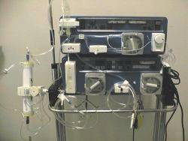
Acute Kidney Patients in Tuzla 1992-1994
69 patients average age 38.22 ± 14.14 years (15-71), 58 men (84.06%) and 11 women (15.94%).
HD therapy received 38 patients (55.07%), 32 male and six female, average age 37.18 ± 13.91 years.
We dialyzed patients in the only way available in those years in our DC:
acetate dialysis with mechanical dialysis machines (GAMBRO AK 10) with water prepared in softeners (reverse osmosis was out of function) and with dialysis solution which we made in hospital thanks to big chemical industry in our town before the war.

Slide 10
Causes of AKI during 1992-1994 in Tuzla Hospital
Causes of AKI | HD group N % | No HD group N % | Total N %
War trauma | 15 21,74 | 0 | 15 21,74
HFRS | 6 8,69 | 17 24,64 | 23 33,33
Mushroom poisoning | 2 2,89 | 2 2.89 | 4 5,79
Other poisoning | 2 2,89 | 1 1,45 | 3 4,35
Gastrointestinal diseases | 5 7,25 | 6 8,69 | 11 15,94
Other | 8 11,6 | 5 7,25 | 13 18,83
Total | 38 55.07 | 31 44.93 | 69

Slide 11
Outcome in the Patients with AKI during 1992-1994 in Tuzla Hospital
 | N | %
Complete recovery | 45 | 65,22
CKF | 4 | 5,8
Oliguric AKI | 39 | 56,52
Mortality HD group | 17 | 44,74
Mortality non HD group | 3 | 9,68
War casualties mortality | 10 | 66,67
Total mortality | 20 | 28,99
Average survival time | 9 days
Leading causes of death | Sepsis in nine Gastrointestinal bleeding in eight patents

Slide 12
Multiorgan Failure in the Patients with AKI during 1992-1994 in Tuzla Hospital
Gasparovic and colleagues followed AKI in one of the biggest hospitals in Zagreb. They had 2130 hospitalized patients with war trauma during 1990-1992. Eleven patients (0.5%) developed AKI with sepsis and multiorgan failure. Mortality was 63.6%.
Colleagues from Croatia also noticed that survival decreased with an increase in the number of organs involved (Gasparovic V, 1999).

Slide 13
Case presentation
In the late spring of 1995, a nine-year-old boy from central Bosnia was admitted to the UCC Tuzla after initial examination in a local health institution because of profound uremia.
Onset was sudden, four or five days back, with back and almost whole body pain, high body temperature and fever. A day before admition, his condition has worsened with loss of apetite, vomiting and anuria.
On the admittion day, a child was concious but confused, prostrated, hypotensive (80/50 mmHg), with heart rate of 120/min. There were no signs of hemorrhage or hemolysis.
There were electrocardiographical signs of high potassium (7,6 mmol/l), with metabolic acidosis, bicarbonates 12 mmol/l, BUN 20 mmol/l, creatinin 600 µmol/l, sodium 138 mmol/l, platelets 120x 10⁹. Ultrasonographically, kidneys were enlarged with pale cortex, distinct renal piramides and empty urinary bladder.

Slide 14
Case presentation
Central line was immidiatelly placed, and hemodialysis commenced, with substantial subjective improvement and correction of electrolite disbalance.
Total of eight HD sessions were done.
Oligo-anuric phase lasted for ten days.
Reconvalescence lasted for additional month, after which the boy recovered, along with normalisation of renal function biochemical paremeters, except loss of of urinary concentrating ability.
Initially suspected hemorrhagic fever with renal syndrome, that actually happened in the middle of the outbreak of 1995, was subsequently serologically confirmed (Dobrava virus).

Slide 15
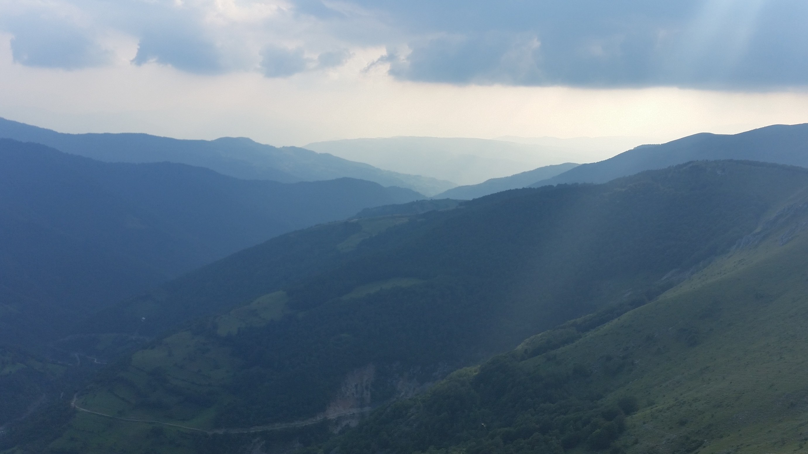
Hemorrhagic Fever with Renal Syndrome (HFRS) in Bosnia and Herzegovina
Bosnia and Herzegovina is a known endemic region for HFRS
The first case was described 1952 (Vranica Mountain).
The big outbreaks happened 1952, 1967, 1986 and during the war, 1994-1995. Sporadic cases we diagnosed every year.

Slide 16
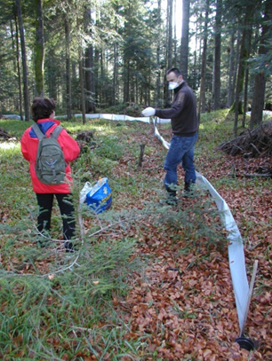
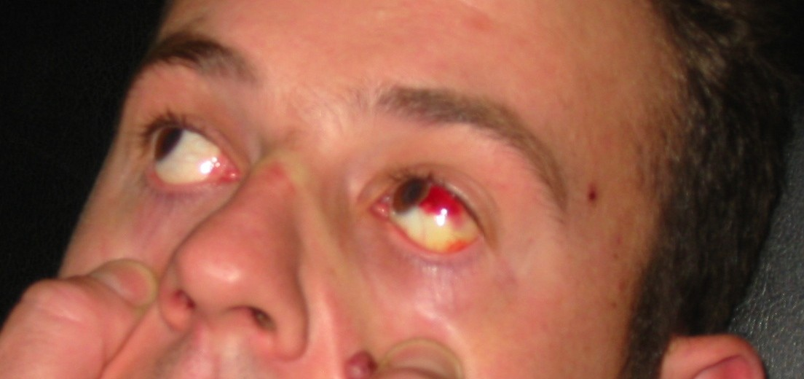
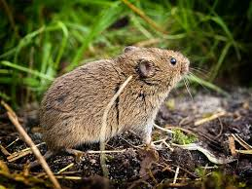
HFRS in Bosnia and Herzegovina – Mouse Fever
Voluharica - Vole
Myodes glareolus

Slide 17
Outbrake of HFRS during 1994-1995 in Bosnia and Herzegovina
HFRS
No of patients | 450
Confirmed diagnosis | 114 | 25,33 %
AKI | 111 | 97,37%
Mortality | 1 | 0,88 %
HD therapy | 6 | 5,26 %
Institute for the control of infectious diseases, Stockholm, Sweden.
ELISA, immunofluorescent test and neutralization test

Slide 18
Outbrake of HFRS during 1994-1995 in Bosnia and Herzegovina
Group | Hantaan (Dobrava) N % | Pummala N % | Increased titer to both viruses N %
I SCr < 200 µmol/L | 0 | 80 | 20
II SCr 200 - 1000 | 7 11,7 | 37 61,7 | 16 26,7
III Scr > 1000 | 12 63,2 | 3 4,4 | 4 14,8
Total | 19 16,7 | 68 59,7 | 27 23,68

Slide 19
Wars, Disasters and Kidney Patients
Despite a huge spectrum of modern dialysis technology and quality of intensive care units, mortality of the critically ill patients with AKI, especially with multiorgan failure, remain disturbingly high even in the developed world.
We have no enough information about number and survival of the patients with AKI and multiorgan failure during the wars and natural disasters in the developing world.
The perception of the war and, frequently, of the natural disasters, are quite different from the victims point of view and from the position of standardized and well-arranged healthcare systems in the developed world.
The guidelines are extremely useful, but often we cannot follow it because of insufficient healthcare system and/or barbarous war.

Slide 20
AKI in Bosnia and Herzegovina 1996 - 2016
Still no exact data
Isolated reports from hospitals
In the most cases late referral to nephrologist (3-5 days), after remarkable increase of creatinine or oliguria
Sepsis, multiorgan failure, polytrauma, severe dehidration and post-surgical AKI (abdominal, cardiovascular and orthopedics) are the most frequent causes of in-hospital AKI
Contrast-induced nephropathy ?

Slide 21
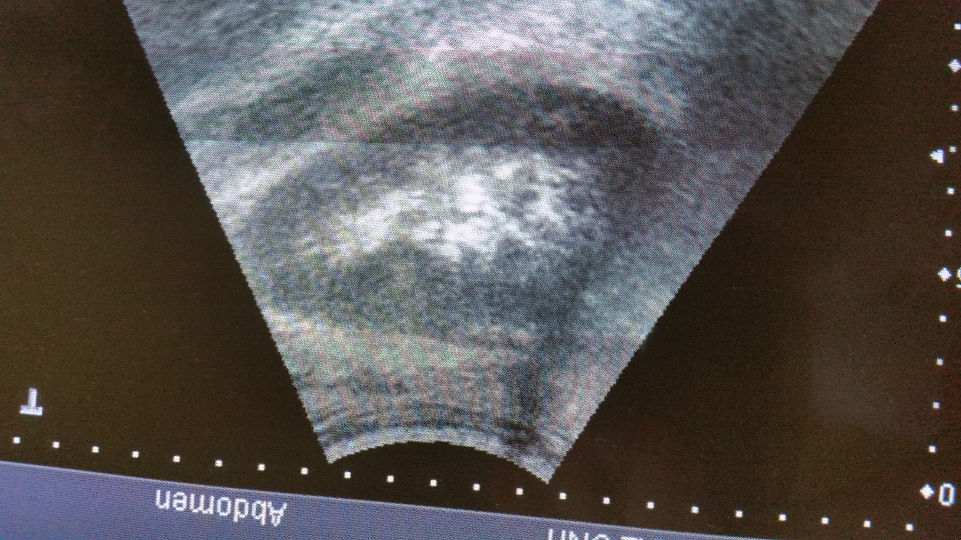
Diagnostic Possibilities and Alerts for AKI
Standard measurements of kidney function
Diuresis measurement
Ultrasound
No routine use of AKI biomarkers
No alert system for AKI

Slide 22
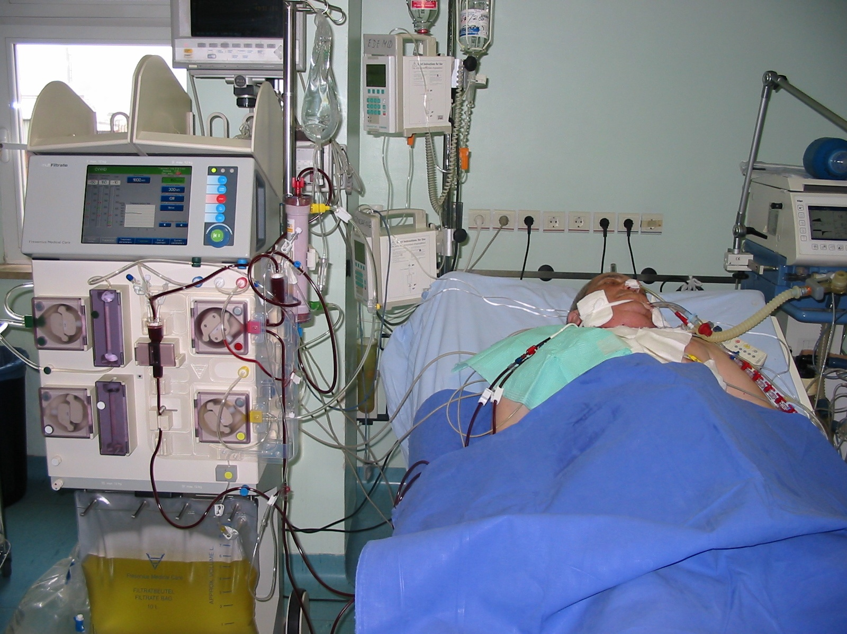
EXTENDED DAILY HEMODIAFILTRATION (EDHDF) IN
THE THERAPY OF ACUTE RENAL FAILURE, Tuzla 2005-2007

Slide 23
Retrospective analysis (2005-2007) of outcome and success of treatment in 12 critically ill patients with AKI and multiorgan failure
10 male, 2 female, average age 48.17 ± 14.59 (24-64) years
Causes of AKI:
Sepsis and posthemorrhagic shock after huge surgical intervention in eight patients
Posthaemorrhagic shock after injury caused by firearm in three patients
Polytrauma after car accident in one patient
All patients were oliguric, eight of them anuric

Slide 24
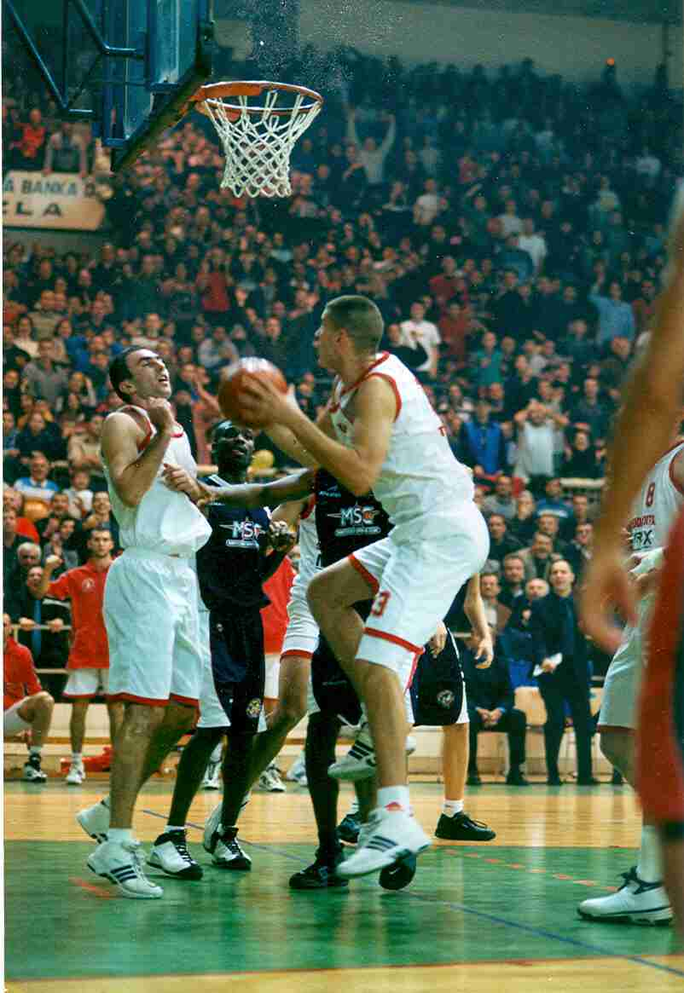
Postdilution EDHDF, surgical intensive care unit
Temporary internal jugular double-lumen venous catheter
93 EDHDF treatments
7.75 ± 4.88 (1-15) days, 7.17 ± 5.45 hours (4.5-24) daily
5 patients fully recovered (41.67%)
7 patients died (58.33%)

Slide 25
Ten Years of Continuous Renal Replacement Therapy (CRRT) at UCS Sarajevo: 2006 - 2015
 | N | %
No of patients | 266
Males | 170 | 63,91
Females | 96 | 36,09
Average age | 55,9 years
CRRT | 1125
CVVHD | 755 | 67,11
CVVHDF | 370 | 32,89
Recovered | 61 | 22,93
Died | 205 | 77,07

Slide 26
Clinical Analysis of Etiology, Risk Factors and Outcome in Patients with AKI, Sarajevo 2012 – 2014
 | N | %
No of hospitalized patients | 1231
AKI cases | 96 | 7,8
Males | 43 | 51,2
Females | 41 | 48,8
Average age | 73.5
Pre-existing CKD | 38 | 45,2
RRT | 18 | 21,4
Recovered | 41 | 48,8
Died | 38 | 45,2
Etiology | %
Acute Interstitial Nephritis | 17
Hearth failure | 15
Acute gastroenterocolitis | 13
Sepsis | 12
Severe dehidration | 8
Other | 34
Hamzic –Mehmedbasic, Mater Sociomed 2015; Hamzic-Mehmedbasic, J Ren Inj Prev, 2016

Slide 27
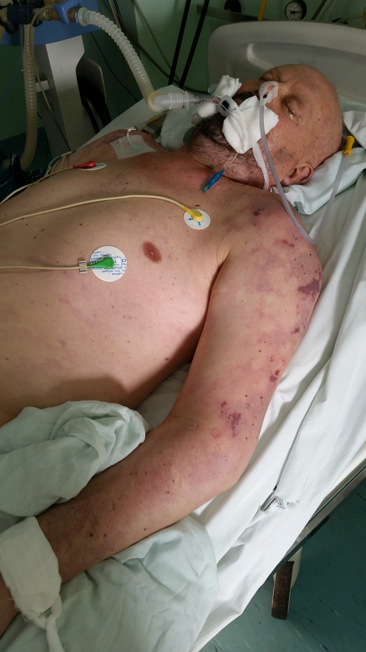
Patient T.H., 60 years
NHL relaps (CNS)
Sepsis, DIC
Multiorgan failure
CVVHDF
Patient died after 30 days

Slide 28
Renal Registry of Bosnia and Herzegovina 2015

Slide 29
Renal Registry of Bosnia and Herzegovina 2015

Slide 30
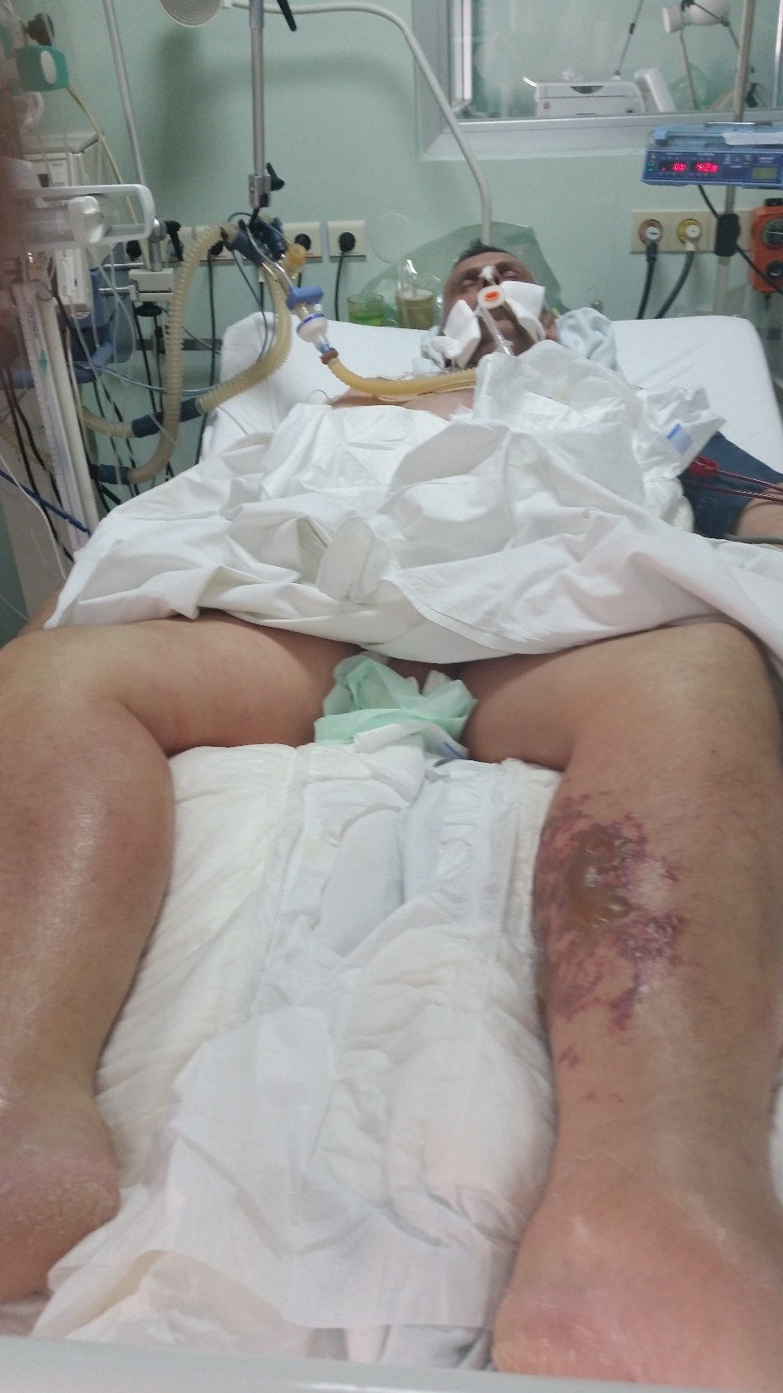
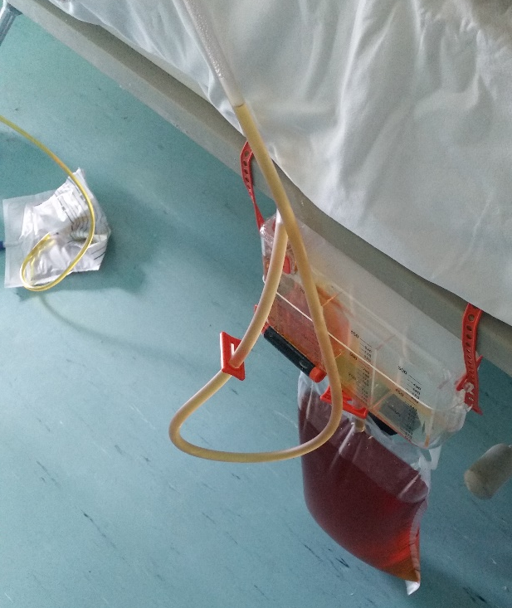
Patient D.F.,
Liver transplantation
Sepsis
Rejectio grafti
Multiorgan failure
CVVHDF
Liver re-transplantation
Died after 50 days

Slide 31
Patients with Multiorgan Failure in ICU, Tuzla 2016
N | Average age | M N % | F N % | Average number of treatments | EL N % | Recovered N %
15 | 54 (15-80) | 12 80 | 3 20 | 7,33 (2-30) | 12 80 | 3 20

Slide 32
Children with AKI, KCU Sarajevo 2006 - 2014
57 children with AKI and dialysis treatment
HUS in 11 patients
2006 - 2016 PD
2009 – 2016 HD
 | N | %
Males | 31 | 54,4
Females | 26 | 42,6
Age | 21 day – 15 years
< 1 year | 34 | 59,6
> 1 year | 23 | 40,3

Slide 33
Children with AKI, KCU Sarajevo 2006 - 2014

Slide 34
AKI in the Newborns hospitalized at the ICU, UKC Tuzla 2013-2015
 | N | %
Hospitalized in ICU | 307
AKI | 21 | 6,84
Female | 15 | 71,43
Males | 6 | 28,57
Average age | 8,4 days
Average weight | 2285 g
Pre-term | 14 | 66,67
Died | 16 | 76,19
Recovered | 5 | 23,81

Slide 35
Acute Rejection and AKI in the Transplanted Patients, UKC Tuzla 1999-2013

Slide 36
Conclusion
Common diagnostic procedures and treatment options in Bosnia and Herzegovina
No standardized procedures on the country level
Late referral to nephrologists
No alerts for AKI in our hospitals
Role of UNDTBH ?

Slide 37
