Slide 1
New option for the treatment of HCV infection in patients on hemodialysis and kidney transplantation
Prof. dr. Halima Resić - KCU Sarajevo; Klinika za hemodijalizu
ISN CME Course „Nephrology Update 2016“

Slide 2
Centres for dialysis and Transplantation in Bosnia & Herzegovina
1005 patients
(38,1%)
Transplant centers in BiH

Slide 3
Patients with positive virus markers

Slide 4
HCV Infection Increases Mortality from Renal Diseases
Cumulative mortality from nephritis, nephrotic syndrome, and nephrosis by serostatus of antibodies against HCV and serum HCV RNA level at study entry
6
HCV RNA seropositive
The cumulative mortality from renal diseases was 0.47%, 0.92% and 1.48% for anti-HCV seronegatives, anti-HCV seropositives with undetectable serum HCV RNA and anti-seropositives with detectable serum HCV RNA, respectively (p=0.008)
HCV RNA seronegative
5
Anti-HCV seronegative
4
Cumulative risk (%)
3
2
1.48%
1
0.92%
0.47%
0
0
2
4
6
8
10
12
14
16
18
20
Follow-up years
Lee MH, et al. J Inf Dis 2012:206:469‒77.

Slide 5
Relationship Between HCV and Chronic Kidney Disease (CKD)
HCV precipitates certain forms of glomerular disease that lead to CKD:
Membranoproliferative glomerulonephritis (MPGN) is the most common
Kidney Disease
Chronic HCV
Cirrhosis can lead to changes in renal perfusion/blood flow that affect function.
In the most severe case, termed hepatorenal syndrome (HRS), the kidneys fail due to complications of advanced liver disease.
HCV may progress to liver fibrosis and subsequently cirrhosis and hepatocellular carcinoma
Liver Disease
Perico N, Cattaneo D, Bikbov B, Remuzzi G. Clin J Am Soc Nephrol. 2009;4(1):207-220.
Slack A, Yeoman A, Wendon J. Critical Care. 2010;14:214.
Renal B3 | June 2016 |For internal use only| Company Confidential © 2016
Notes:
Chronic kidney disease (CKD) can be both a cause and a result of chronic HCV.
Chronic HCV also leads to liver disease progression, which can contribute to the progression of kidney disease.
These interactions will be explored in the next three slides.
References:
Perico N, Cattaneo D, Bikbov B, Remuzzi G. Hepatitis C infection and chronic renal diseases. Clin J Am Soc Nephrol. 2009;4(1):207-220.
Slack A, Yeoman A, Wendon J. Renal dysfunction in chronic liver disease. Critical Care. 2010;14:214.

Slide 6
HCV Infection Is Associated With a Higher Incidence of Renal Impairment, a Faster Rate of Renal Function Decline, and a Higher Hazard of ESRD*
Impaired renal
function (↓GFR)
15%
higher incidence
Faster rate
of GFR decline
22%
higher risk
ESRD
98%
higher hazard
Cohort study of US veterans data 2004–2006: n=100,518 HCV+ vs. n=920,531 HCV−
HCV+ patients: mean age 53 years; 96% male; 60% white; 36% black; 53% hypertension; 21% diabetes mellitus
Molnar M, et al. Hepatology 2015;61:1495–502.
Renal B3 | June 2016 |For internal use only| Company Confidential © 2016

Slide 7
HCV-infected Patients Have Higher Rates of Mortality Due to Renal and Circulatory Diseases Than Uninfected Patients
Community-based cohort study of 23,820 individuals aged 30–65 years (11,973 men and 11,847 women) enrolled in 1991–1992 and followed until December 2008
Cumulative mortality from nephritis, nephrotic syndrome, and nephrosis*
Cumulative mortality from
circulatory diseases*
6
HCV RNA seropositives
HCV RNA seronegatives
Anti-HCV seronegatives
6
HCV RNA seropositives
HCV RNA seronegatives
Anti-HCV seronegatives
5
5
5.0%
4
4
3.5%
Cumulative risk (%)
2.9%
3
3
2
2
1.48%
1
0.92%
1
0.47%
0
0
0
2
4
6
8
10
12
14
16
18
20
0
2
4
6
8
10
12
14
16
18
20
Follow-up years
Follow-up years
P= 0.008 for comparison among 3 groups
P= 0.71 for HCV RNA detectable vs. undetectable
P= 0.05 for comparison among 3 groups
P= 0.36 HCV RNA detectable vs. undetectable
*Cumulative mortality by serostatus of antibodies against HCV (anti-HCV) and serum HCV RNA level at study entry.
Lee MH, et al. J Infect Dis 2012;206:469–77.
Renal B3 | June 2016 |For internal use only| Company Confidential © 2016

Slide 8
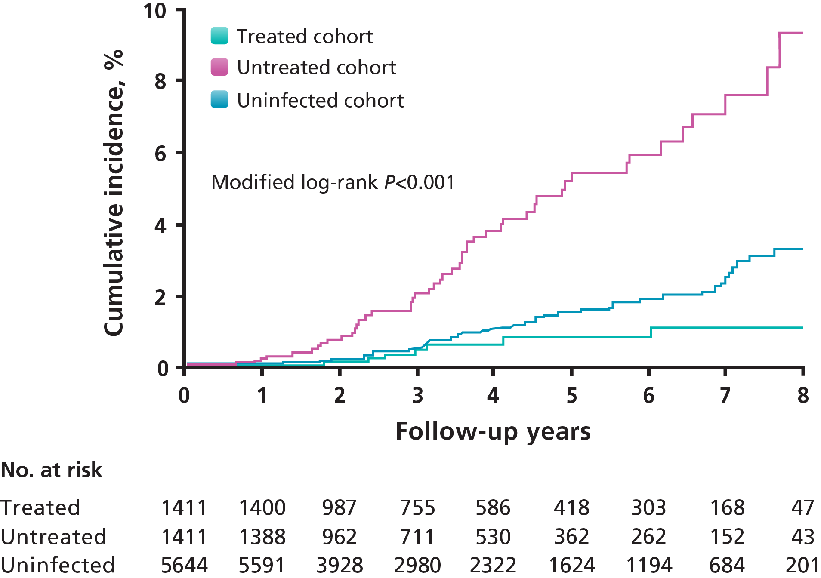
Treatment of HCV Decreases Risk of ESRD
Hsu YC, Lin JT, Ho JH, et al. Hepatology. 2014;59:1293-1302.
Renal B3 | June 2016 |For internal use only| Company Confidential © 2016
Notes:
This study enrolled diabetic patients ages 20 to 70 years who had been continuously using diabetes medication for more than 90 days. Among HCV-infected patients, those who received antiviral treatment with pegylated interferon (PegIFN) plus ribavirin between October 1, 2003, and December 31, 2010, were grouped into the treated cohort.
The incidence of ESRD was lowest in the treated cohort. ESRD occurred cumulatively at 8 years in 1.1% (95% CI, 0.3-2.0%), 9.3% (95% CI, 5.9-12.7%), and 3.3% (95% CI, 2.3-4.3%) of the treated, untreated, and uninfected cohorts, respectively (P<0.001).
As compared with the untreated cohort, antiviral treatment was associated with multivariate-adjusted hazard ratios of 0.16 (95% CI, 0.07-0.33%) for ESRD.
Reference:
Hsu YC, Lin JT, Ho JH, et al. Antiviral treatment for hepatitis C virus infection is associated with improved renal and cardiovascular outcomes in diabetic patients. Hepatology. 2014;59:1293-1302.

Slide 9
KDIGO, AASLD/EASL Guidelines: Recommendations for the Treatment of HCV-infected Patients With Renal Insufficiency
Diagnosis and management of kidney diseases associated with HCV infection¹
Proteinuria, nephrotic syndrome, or membranoproliferative glomerulonephritis
“It is suggested that HCV-infected patients be tested at least annually for proteinuria, hematuria, and eGFR to detect possible HCV-associated kidney disease”
“We recommend that prescribers should take GFR into account when drug dosing” – KDIGO, 2008
Highest priority for treatment owing to highest risk for severe complications²
Patients with clinically significant extrahepatic manifestations (eg, HCV-related cryoglobulinemia)
Treatment should be prioritized³
1. KDIGO Guidelines CKD. Kidney Int 2013;(Suppl 3):5–14.
2.AASLD Recommendations; http://hcvguidelines.org/full-report-view 3. EASL Recommendations on Treatment of Hepatitis C. J Hepatol 2015;63:199-236.
AASLD, American Association for the Study or Liver Diseases; EASL, European Association for the Study of the Liver.
Renal B3 | June 2016 |For internal use only| Company Confidential © 2016

Slide 10
Inclusion of Patients With Renal Insufficiency in Clinical Trials
OBV/PTV/r + DSV Trials
CrCl exclusion cut-off (ml/min) | SAPPHIREI,II,III | PEARLII,III,IV | TUR-QUOISE-II | TUR-QUOISE-I (part2) | TUR-QUOISE-III | TOPAZ-I | GARNET | RUBY-I | RUBY - II
CrCl < 90 ml/min
CrCl < 60 ml/min
CrCl < 30 ml/min
ESRD incl. HD
SAPPHIRE I: NCT01716585; SAPPHIRE II: NCT01715415; SAPPHIRE III: ; PEARL II, NCT01674725; PEARL III, NCT01767116;
TURQUOISE I, NCT01939197; TURQUOISE II, NCT01704755; TURQUOISE III, NCT02219503;
TOPAZ I, NCT02219490; GARNET, NCT02582632; RUBY I, NCT02207088

Slide 11
Efficacy of OBV/PTV/r + DSV + RBV in HCV GT1 Patients With Mild Renal Impairment Enrolled in 6 Phase 3 Trials (N=2005)
Post-hoc pooled analysis of PEARL-II, -III, -IV, SAPHIRRE-I, -II and TURQUOISE-II
Without cirrhosis
Overall
GT1a
GT1b
With cirrhosis
833
862
624
649
469
490
318
340
363
371
306
309
188
199
155
166
645
663
468
482
RBV dose was reduced in 7% (110/1511) of patients who received RBV, predominantly due to decreases in hemoglobin
High rates of SVR were seen despite dose reductions of RBV
Sulkowski MS, et al. HEPDART 2015 (poster); www.natap.org/2015/hepDART/hepDART_04.htm

Slide 12
RUBY-I Efficacy: OBV/PTV/r + DSV ± RBV in Non-cirrhotic GT1–infected Patients With Severe Renal Impairment and ESRD
OBV/PTV/r + DSV + RBV (12 weeks) was efficacious and well-tolerated in HCV+ patients with severe renal impairment (GFR 15–30 mL/min/1.73m²) and ESRD (GFR <15 mL/min/1.73m²)
GT1b: 100% SVR (7/7)
GT1a: 92% SVR (11/12 - mITT)
18
20
n
N
18
19
SVR12
(ITT)
SVR12
(mITT)*
*Death due to left ventricular systolic dysfunction/cardiac arrest; unrelated to DAAs or RBV (had undetectable HCV RNA); †Black male, 49 years, on dialysis, GT1a, F3 fibrosis, IL28B CT genotype, BMI 37 kg/m².
Pockros PJ, et al. Gastroenterology 2016; Epub ahead of print.

Slide 13
OBV/PTV/r ± DSV ± RBV Real-world Data: An Observational, Multicenter, Retrospective Study of 33 Patients in Madrid With GT1 or GT4 Infection and CKD Stage 4 or Stage 5*
Baseline characteristics | N=33
Mean age, years (SD) | 57 (39−78)
Male, n (%) | 23 (69)
Degree of fibrosis, n (%)
F0−F1 | 12 (36)
F2 | 4 (12)
F3 | 4 (12)
F4 (Child-Pugh A) | 13 (39)
HCV viral load, log median (min, max) | 6.21 (2.29–7.44)
Genotype, n (%)
1a | 6 (18)
1b | 23 (70)
4 | 3 (9)
1b and 4 | 1 (3)
CKD stage, n (%)
CKD 4 | 7 (11)
CKD 5 | 26 (79)
Treatment-experienced, n (%) | 8 (25)
12–24 weeks OBV/PTV/r ± DSV ± RBV
No cases of treatment failure or relapse observed
33
33
31
31
14 patients received RBV; RBV was interrupted in 2 patients; 3 patients required RBV dose reductions; EPO increased in 6 patients
5 patient (15%) experienced SAEs† (not considered to be treatment-related)
No patients discontinued treatment due to AEs
EPO, erythropoietin; ITT, intent to treat. *Stage 4 = eGFR 15–30 mL/min/1.73 m²; Stage 5 = eGFR <15 mL/min/1.73 m² or requiring dialysis; †1 pneumonia, 2 heart failure, 1 atrial fibrillation, 1 gout.
Gomez et al. EASL 2016, Barcelona: #SAT-248
Renal B3 | June 2016 |For internal use only| Company Confidential © 2016

Slide 14
OBV/PTV/r ± DSV ± RBV Real-world Data: SVR Rates in Patients With Renal Impairment in the German Hepatitis C Registry
100% SVR in patients with an eGFR <60 incl. dialysis (34/34)
SVR12/24 (%)
4
4
5
5
25
25
152
159
296
305
(Incl. dialysis)
GFR (ml/min/1.73m²)*
Hinrichsen et al. EASL 2016, Barcelona: #GS07
*60/558 patients with unknown GFR not included in this analysis.
Renal B3 | June 2016 |For internal use only| Company Confidential © 2016

Slide 15
OBV/PTV/r ± DSV ± RBV in Patients With Renal Insufficiency
Regular monitoring of renal function by eGFR and early treatment of HCV is important to avoiding further complications and mortality associated with patients with CKD and HCV
OBV/PTV/r and DSV are cleared by non-renal metabolism
Elimination via the renal route is negligible (≤1.5%)
No dosage adjustment of OBV/PTV/r + DSV is required in patients with mild, moderate, or severe renal impairment
100% SVR12 (7/7) in GT1b patients and 92% SVR12 (11/12 – mITT) in GT1a patients in RUBY-1, cohort 1.
Renal B3 | June 2016 |For internal use only| Company Confidential © 2016
Notes:
This slide summarizes key points about the use of OBV/PTV/r and DSV in patients with renal insufficiency.

Slide 16
AASLD: Recommendations for Testing, Managing, and Treating Hepatitis C, 2016
Persons on hemodialysis. The prevalence rate of HCV infection is markedly elevated in persons on hemodialysis and ranged from 2.6% to 22.9% in a large multinational study. (Fissell, 2004)
HCV-infected persons on hemodialysis have a decreased quality of life and increased mortality compared with uninfected persons on hemodialysis. (Fabrizi, 2002)
The summary of recommendations for patients with renal impairment, including severe renal impairment (creatinine clearance [CrCl] <30 mL/min) or end-stage renal disease (ESRD) requiring hemodialysis or peritoneal dialysis
For patients with genotype 1b infection and CrCl below 30 mL/min for whom the urgency to
treat is high and renal transplant is not an immediate option, daily fixed-dose combinationof
paritaprevir (150 mg)/ritonavir (100 mg)/ombitasvir (25 mg) plus twice-daily dosed dasabuvir
(250 mg) for 12 weeks is a Recommended regimen.
Rating: Class IIb, Level B
For HCV genotype 1a infection, daily fixed-dose combination of paritaprevir (150 mg)/ritonavir (100 mg)/ombitasvir (25 mg) plus twice-daily dosed dasabuvir (250 mg) with RBV at reduced doses (200 mg thrice weekly to daily*) for 12 weeks is an Alternative regimen. However, caution is recommended in this group, owing to the potential for hemolytic anemia due to impaired renal clearance in this population, and RBV should be restricted to those with a baseline hemoglobin concentration above 10 g/dL.
Rating: Class IIb, Level B

Slide 17
US SUMMARY OF PRODUCTCHARACTERISTICS (dasabuvir, ombitasvir, paritaprevir, and ritonavir)
8.7 Renal Impairment
No dosage adjustment of VIEKIRA XR is required in patients with mild, moderate or severe renal impairment, including those on dialysis. For patients that require ribavirin, refer to the ribavirin prescribing information for information regarding use in patients with renal impairment

